Slide 1
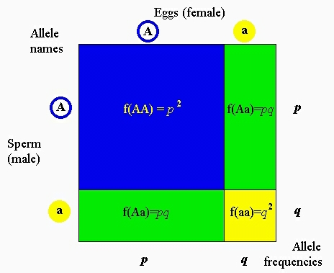
Hardy Weinberg Equilibruim Equation Reflects the frequency of alleles in a population of organisms under ideal conditions. 64NB
p² + 2pq + q² = 1
p + q = 1

Slide 2
Hardy Weinburg Equilibrium
Applies only to sexually reproducing organisms.
The Conditions that must be met for a population to be in Hardy Weinburg Equilibrium are:
No new mutations, alleles in a population do not change
No different selection among genotypes (No Natural Selection)
No gene flow ( immigration and emigration)
Population size has to be infinite, or at least very large.
Mating is Random

Slide 3
If all ideal conditions are met, then there is no evolution because the allelic frequency is maintained in the population .
The concept of HW Eq. Is important because deviation from the HW Eq. show that evolution is occurring and can help us identify the various mechanisms of evolutionary change.

Slide 4
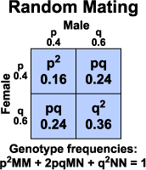
An example:
500 Wild Flowers
Frequency C^{R} allele in the population: .8 = p
Frequency C^{W} allele in the population:.2 = q
What is the genotypic probability of Homozygous dominant Red Wild Flowers(C^{R}C^{R})?, Heterozygous Pink Wild Flowers (C^{R}C^{W}), and Homozygous recessive White Wild Flowers? (C^{W}C^{W})

Slide 5
Taster vs. Nontaster
What percent of the North American population is Heterozygous for the taster trait?
Start with what you know: q² = .45
p + q = 1;
q = .45
1 – q = p; 1 - .67 = .33 = p
p² = .1089
2pq = 2 x .33 x.67 = .44
Tt = .44
Make sure your genotypic probabilities = 1
.1089 + .44 + .45 = 1

