Slide 1
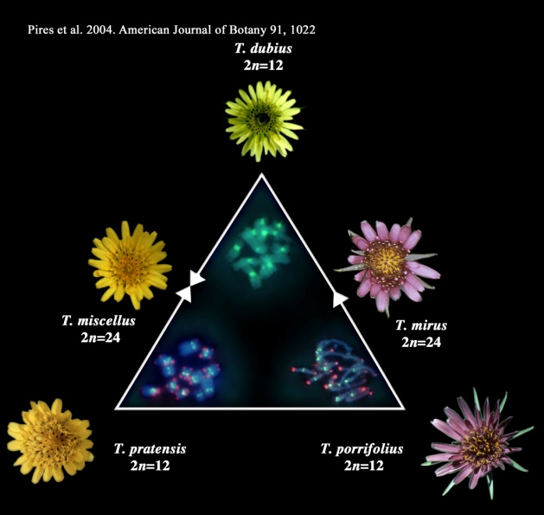
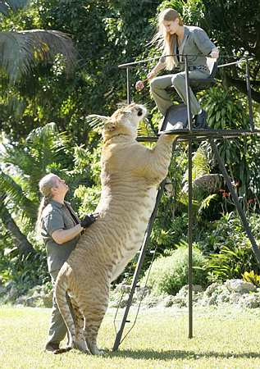
Allopolyploid
Allopolyploid refers to the contribution of two different species to a polyploidy hybrid.
An example of a Allopolyploid is a liger. It’s a combination of a lion and tiger and is usually sterile (cannot reproduce).
When two polyploidy organisms mate, they create a new hybrid polyploidy organism that differs from either parent. The hybrid is usually sterile because the haploid set of chromosomes from this species cannot pair during meiosis with the haploid set of another species.
Allopolyploid is the result of the mating of two different species like a lion and a tiger to produce a new kind of specie (liger).

Slide 2
Exceptions to Sterility
A hybrid may be infertile but in the case of plants it can propagate itself asexually.
Various mechanisms can change a sterile hybrid into a fertile polyploid.
The polyploid hybrids are fertile with each other but cannot interbreed with either parental speices

