Slide 1
POSTZYGOTIC BARRIERS
Anushka Kumar
Dennison Ocampo
Karen Luis
Sidrah Khan
Anna

Slide 2
Assertion
Postzygotic barriers are when a sperm cell and a cell from two diferrent species mate and are usually prevent hybrid zygote from developing into a viable, fertile adult.

Slide 3
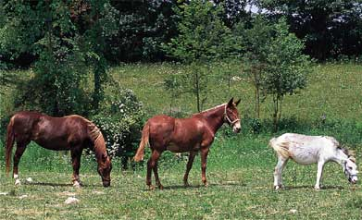
eXample
Horse + Donkey= Mule(hybrid).

Slide 4
Explanation
There different are different types of Postzygotic Barriers:
Reduced hybrid-when prezygotic barriers are crossed and hybrid zygotes are formed, genetic incompatibilty between the two species may abort development of the hybrid at some embroyonic stage.

Slide 5
Significance
Without postzygotic barriers there would be a viable , fertile adult.
If it wasn’t for postzygotic barriers then the horse and the donkey wouldn’t be able to have the mule.

