Slide 1
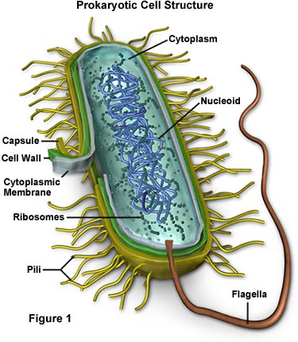
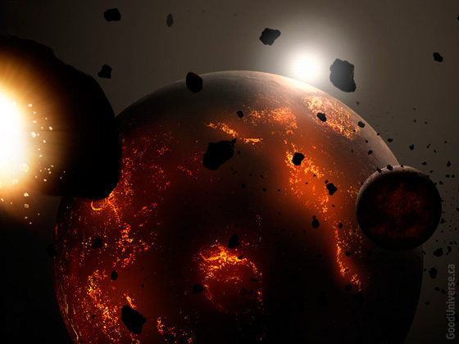
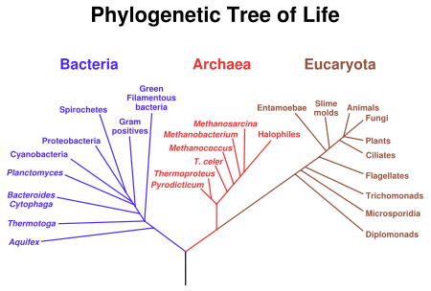
CH 25 & 26 & 27 Phylogeny & Systematics Early Earth & the Origin of Life & Prokaryotes

Slide 2
Phylogeny-evolutionary history of a species or related species.
Systematics – the study of biological diversity in an evolutionary context.
Use the fossil record to mark geologic time – Sedimentary rocks (richest fossils),
Relative Dating –No, not that kind. Younger fossils on the top layer, older fossils in the deeper layers. (before, after, early, late)
Radiometric Dating – the measure of certain radiometric isotopes in fossil or rocks.
Isotopes: Carbon 12, radioactive Carbon-14(5,730 years)→Nitrogen 14
Fixed rate of decay – Half- life ( # of years it takes 50% of the original sample to decay
Uranium -238→ Lead206– 4.5 billion years (not present in living organisms)

Slide 3
Geologic Time scale
Only a fraction of species were made fossils, most of the fossils have been destroyed by environmental effects, and only a fraction of those have been discovered, thus the fossil record is incomplete.
The history of Earth helps explain the current distribution of species.
Continental Drift
Biological Diversity
Pangea-250million years ago
Mass Extinctions

Slide 4
Systematics – the study of biological diversity in an evolutionary context.
Linnaeus – Taxonomy – 2 name naming system (binomial).
Genus species – Panthera pardus (leapard)
Panthera leo
Panthera tigris
Homo sapiens (wise man)
Phylogenetic trees & Cladograms
3 Domains, 6 Kingdoms, Phylum, Class, Order, Family, Genus, species

Slide 5
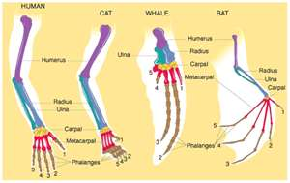
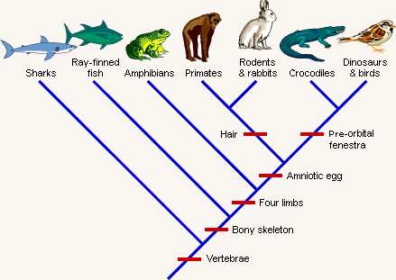
Constructing Cladogram show derived characteristics
Divergent Evolution – homology – forelimbs of mammals – common ancestry.
Convergent Evolution – Analogy – bird wing & bat wing, same function – flight
Molecular data:
Molecular clocks – gene evolves
At a relatively constant rate.

Slide 6
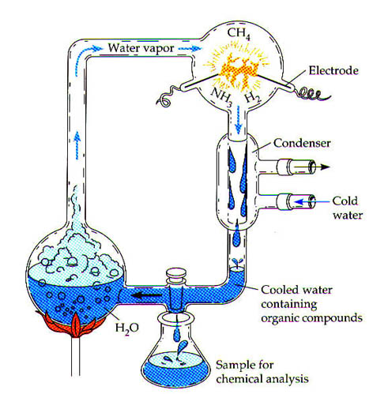
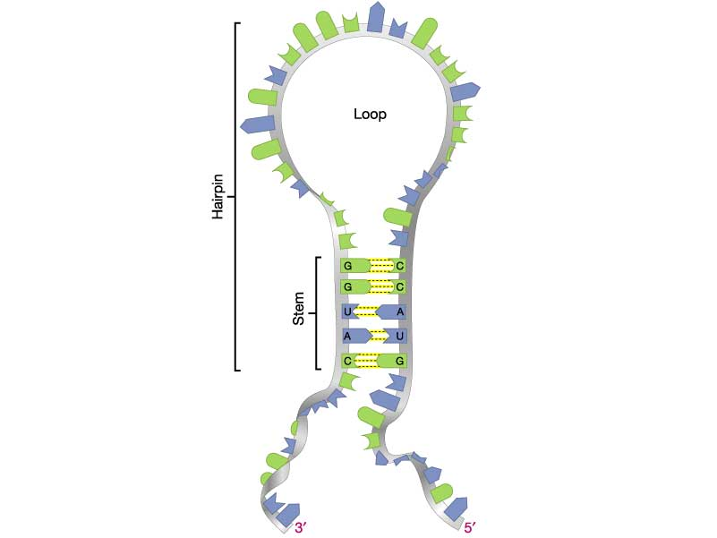
Miller – Urey Experiment “Atmosphere” H₂O, H₂, CH₄, NH₃, the solution was a variety of organic compounds including Amino acids that make up proteins of organisms.
RNA- initial Nucleic Acid, but eventually gave way to DNA because it was more stable.
Ribozymes – RNA cataylsts, help the synthesis of new RNA – rRNA, tRNA, & mRNA

Slide 7
Prokaryotes & Metabolic Diversity
More benign or beneficial bacteria than harmful.
Intestine- important vitamins
Mouth – prevents harmful fungi from growing
Decompose dead organisms – recyclers
They can live without us, but we can not live without them.
Symbiotic relationships- mitochondria & chloroplasts evolved from prokaryotes that became residents of larger cells.

Slide 8
Bacteria & Archaea (Monera) -unicellular, however can have division of labor.
Ribosomal RNA and sequences genomes of bacteria
3 common shapes – bacilli (rod), cocci (spheres), helices (spirilla)
Cell Wall (bacteria)– peptidoglycan, forms shape & physical protection, prevents cell from bursting (hypotonic env.)
Differences between bacteria and Archaea:
Gram-positive – (violet dye) simpler walls, + peptidoglycan
Gram – Negative – (red dye) Less peptidoglycan, structurally more complex, lipopolysaccharides (toxic) in disease causing bacteria, more resistant to antibiotics
Plasmolyze – shrink away from their wall (hypertonic env.)
Salted foods (meat) can be kept longer w/o spoiling
Mobility – Flagella, helical filaments, taxis(movement toward or away)

Slide 9
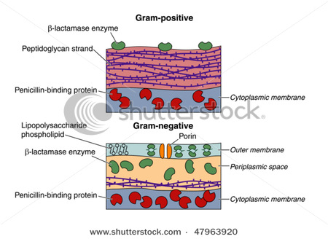
Archaea – extreme environments “ancient”, hot springs, bottom of trenches (resemble habitats of early earth).
Structural
Biochemical
Physiological

Slide 10
