Slide 1
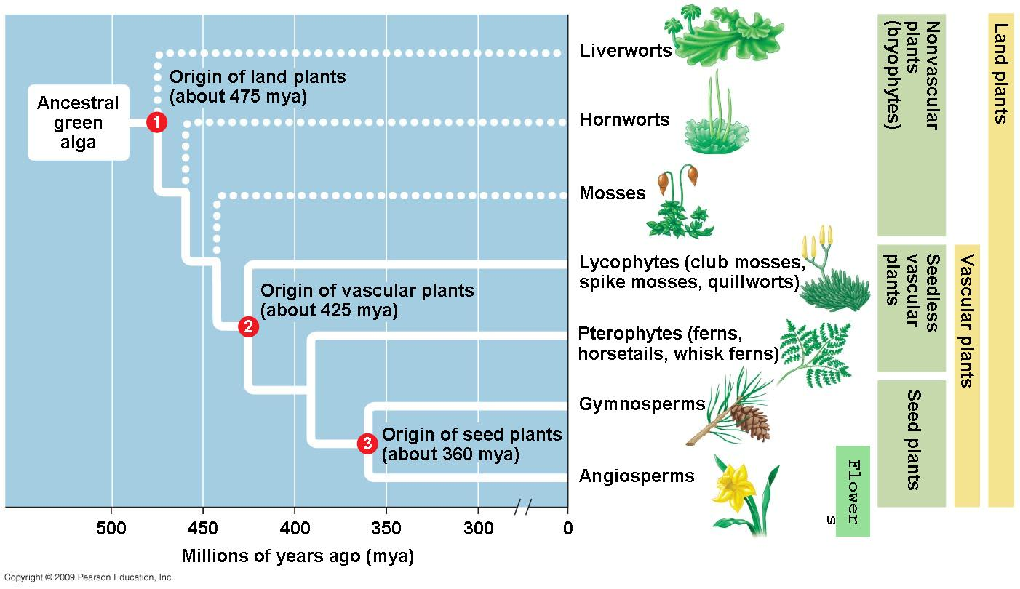
CH 29 How plants colonized the land, 30 Evolution of seed plants, 35 Plant Structure & Growth
11/7 Obj. TSW demonstrate understanding of how plants photosynthesize by performing the leaf disk assay lab.

Slide 2
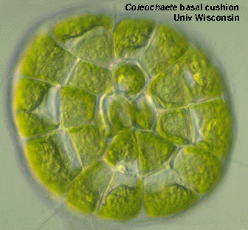
Plant characteristics
Multicellular, eukaryotic, photosynthetic autotrophs,
cells walls –cellulose and Chlorophylls a & b, monophyletic
Charophyceans- closest algal relative to plant kingdom, inhabited shallow waters around edges of ponds and subject to occasional drying
Homologous chloroplasts
Cellulose microfibrils of cell walls
Enzymes – peroxisomes (associated with chloroplasts
Flagellated sperm cells
Cell division – formation of cell plate (phramoplasts)
Ribosomal RNA & chloroplast DNA connect Charophyceans to plants
Apical Meristems – localized regions of cell division at the tips of shoots and roots
Multicellular dependent embryos – derived characteristics to land plants

Slide 3
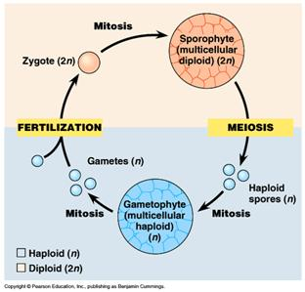
Alternation of generation:
Gametophyte (haploid) & sporophytes (diploid)
Meiosis in the sporophytes produces haploid reproductive cells – spores
Spore can develop into a new organism (gametophyte) w/o fusing with a another cell
Mitotic division of the spore produces a new multicellular gametophyte that produces gametes that unite to form the zygote that develop into a sporophyte

Slide 4
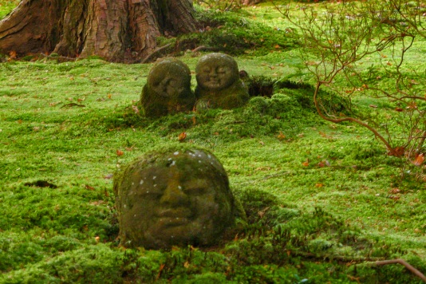
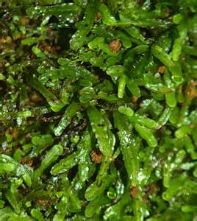
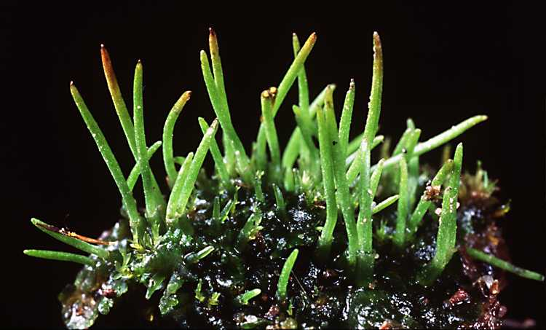
Four main groups of land plants: Bryophytes, Pteridophytes, gymnosperms, Angiosperms, (10 plant phyla)
Bryophytes – mosses, liverworts, hornworts
Have reproductive adaptations different from algae
Offspring develop from multicellular embryos that remain attached to the “mother” plant, which protects and nourishes the embryo.
Lack vascular tissue, but do have water conducting tubes
No true roots, stems or leaves
Dominant generation: gametophyte form
Dispersal of spores by wind

Slide 5
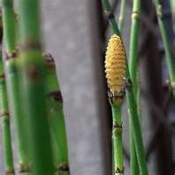
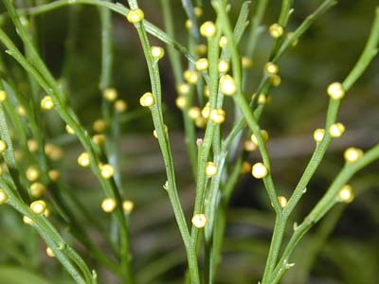
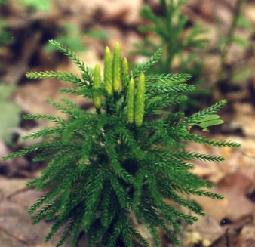
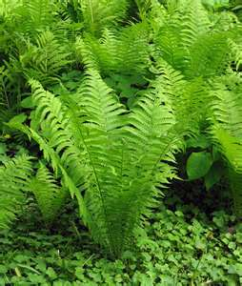
Pteridophytes Lycophytes (Club Moss), Pterophyta (ferns, whisk ferns, horse tails)
Vascular tissue, but no seeds
Cells are honed into tubes that transport water and nutrient throughout the plant body
Xylem – transport water
Phloem – transports sugar
Sporophyte generation – dominant form

Slide 6
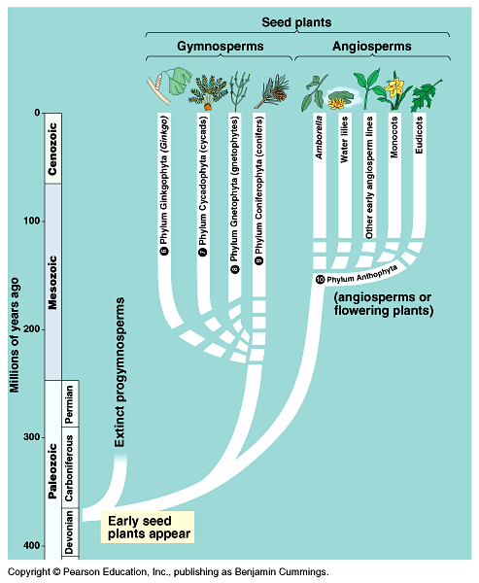
Gymnosperms- naked seed (Conifers)
Vascular and seeds (facilitating reproduction on land), cone bearing
360 million years ago
Sporophyte generation – dominant form
Transfer of pollen to the ovule – Pollination
4 Phyla of gymnosperms
Ginko-fan-like leaves, deciduous
Cycads- resemble palms
Gnetphytes- shrub-like
Conifers –pine trees, redwood

Slide 7
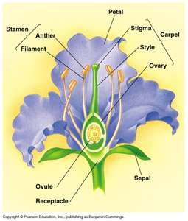
Angiosperms
Vascular, seeds and flowering plants
130 million years ago
Protective coat and ovary around seed- fruit
(protects the seed, helps it get eaten and carried to a different place to decrease competition with parent plant
Sporophyte generation – dominant form
Monocots(one cotyledon - corn), Dicots (two cotyledon - bean)
Coevolution – Angiosperms & animals
Flying insects – pollination (creates diversity of flowers)
Agriculture – fruit & vegetable crops: corn, rice, wheat (selective breeding- artificial selection)
Sustainability – plant diversity – nonrenewable resource, extinction of plant species and animals that depend on them
Available medicines
Available resources – housing
Economy- jobs - balance

Slide 8
Complete Flower

Slide 9
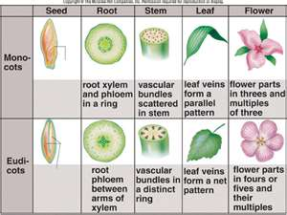
Plant structure & growth
Roots, Stems Leaves - organs
Hierarchy of structural levels: multicellular organism, consisting of organs composed of tissues, with different types of cells
Monocots – fibrous root system
Dicots – taproot
Root hairs- increases the surface area to absorb water and minerals and anchor the plant
Stems – have nodes – give rise to leaves
Leaves – main photosynthetic organ

Slide 10
Plant organs: 3 tissues- dermal, vascular & ground
Dermal – epidermis, single layer of tightly packed cells that covers & protects all young parts of the plant.
Also have specialized characteristics consistent with the function
Ex. Leaves – cuticle (waxy) to reduce water loss
Roots – root hairs, to increase water absorbtion
Vascular
Xylem – moves water and dissolved minerals upward
Phloem – transports food made in leaves to roots and developing leaves and fruits.
Ground
Photosynthesis, storage, and support
Pith- internal to vascular tissue
Cortex – external to the vascular tissue

Slide 11
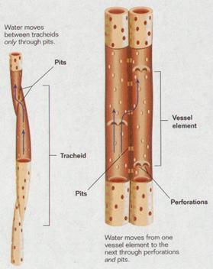
Plant Cells
Xylem- Tracheids – water transport
Vessel element – transports water, but the cell itself is dead at maturity
Phloem - Sieve- tube members -Sucrose transportation
Lack a nucleus, ribosomes, and distinct vacuole
Sieve plates – end walls between sieve tube members
Companion Cell – along side the sieve tube member, help load sugar produced in the leaf. It does have a nucleus and ribosomes that serve the adjacent sieve-tube member.
Parenchyma – “typical” plant cell, not specialized, primary walls, thin and flexible, large central vacuole. It performs metabolic functions for the plant (photosynthesis)
Collenchyma – thicker primary walls, uneven, help support young parts of the plant (celery stalk), provide support
Sclerenchyma – occur in regions of the plant that have stopped growing, thick secondary wall, do not elongate

Slide 12
Alternation of Generations P. 27
With the following cards, place them in order and write the order in your notebook. You have three minutes… GO!
Meiosis, Mitosis, Gamete, Spore, Fertilization, Sporophyte, Gametophyte, Zygote
P. 611 Life cycle of an Angiosperm
Sporophyte (2n) → meiosis → spore (2n) → gametophyte (n)→ gametes (n) → fertilization → zygote→ mitosis → Sporophyte

Slide 13
Word Association- Say the scientific name
Pine cone
Flower
Moss
Fern
Vascular/seeds/no flowers
Nonvascular
Vascular /Seedless
Vascular/seeds/ flowers
Double fertilization
Finish Your test – I am grading it Thursday!

Slide 14
Bloody Chlorophyll
Why does the chlorophyll look red?
We extracted the chlorophyll from the membrane.
The electrons still get excited when light shines on the molecule and move up in energy state.
However, they don’t have anywhere to go since they are not embedded in the membrane and don’t have an electron transport chain to be passed off to.
So the electrons “fall back down” to a lower energy level and the excess energy is emitted as red light.

Slide 15
Leaf Disk Assay Lab (if the row does not add up to 10, the disk did not rise)
 | 5 min | 10 min | 15 min | 30 min | 45 min | 60 min | 90 min | 2 hours
0 Bicarbonate | 0 | 0 | 0 | 0 | 0 | 0 | 0 | 0
.5 tsp Bicarbonate | 0 | 0 | 0 | 1 | 2 | 3 | 1 | 0
1 tsp bicarbonate | 0 | 0 | 0 | 2 | 2 | 4 | 2 | 0
2 tsp bicarbonate | 0 | 1 | 1 | 5 | 1 | 1 | 0 | 1

