Slide 1
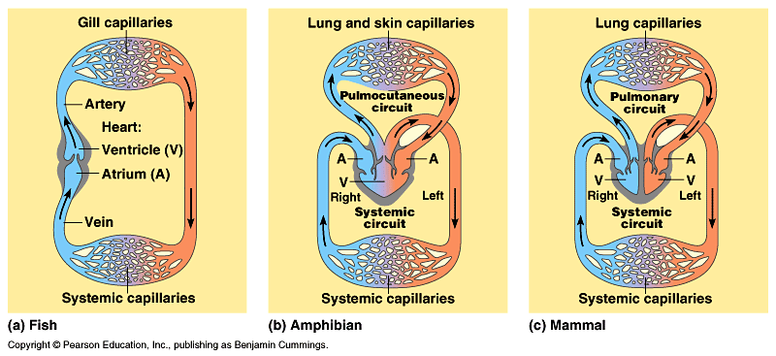
Circulation & Gas Exchange
Obj: TSW understand and demonstrate circulation & gas exchange through the use of heart models by drawing the pathway of blood. 47 NB

Slide 2
Internal Transport in Invertebrates
Animals w/o a backbone – Invertebrates
Jellyfish (Cnidaria), planaria (flat worms), arthropods (grasshopper)
Open Circulatory System
No distinction between blood & interstitial fluid
Hemolymph – body fluid
Chemical exchange happens at sinuses
Heart (pumps) hemolymph in contact with body tissues to exchange respiratory gases: O₂ & CO₂
When the heart relaxes, hemolymph enters the “heart” through pores called ostia.
O2 infiltrates insects body through air ducts called tracheae

Slide 3
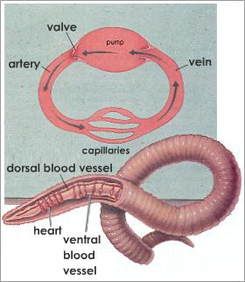
Closed Circulatory System (Cardiovascular System)
Annelids (segmented worms) Vertebrates & some Mollusks have closed circulatory system
Blood is confined to vessels (capillaries, venules, veins, arterioles, arteries)
Evolutionary Perspective of Vertebrate Circulatory System: Fish-2 chambered heart, Amphibians – 3 chambered heart, Reptiles 3.5 chambered heart-partially divided septum. (crocodiles have a completely divided septum so the ventricle has 2 chambers)

Slide 4
The Heart
Size of clenched fist, cardiac muscle
Atria – thin walled compared to ventricle, pumps blood only a short distance to the ventricles.
Ventricles – thicker and more powerful, especially the left ventricle.
Heart Cycle (.8 sec) – systolic & diastolic
Systole – the heart muscle contract (ventricle) and the chambers pump blood
Diastole – ventricles are filling with blood, relaxation
Pulse Rate = 65 – 75 beats / minute

Slide 5
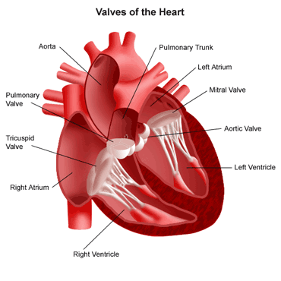
Heart Valves & Heart Sounds
4 Valves – prevent backflow of
blood when ventricles contract
Atrioventricular Valves:
Tricuspic & Mitral Valve
Semilunar Valves: Exits of the heart
Pulmonary & Aortic Valve
“lub-dupp, lub-dupp, lub-dupp”
First heart sound, “lub” is the forceful contraction of the ventricular valve
Second heart sound, “dupp” is the recoil of blood against the semilunar valves

Slide 6
Heart Rate “Pulse” & Cardiac Output
Pulse – number of heartbeats / minute
Count the pulsations of arteries in your wrist or neck.
People who exercise regularly often have slower resting pulses than those who are less fit.
Inverse relationship between size & pulse.
Elephant= 25 beats/ minute
Tiny Shrew = 600 beats / minute
The metabolic rate per gram of tissue is proportionately grater for smaller mammals than for larger ones
Enhances the delivery of oxygen for Cellular Respiration
Cardiac Output –volume of blood / minute, and is determined by heart rate and stroke volume

Slide 7
Excitation and control of the heart
Heart cells are self- excitable (myogenic), they can contract w/o any signal from the nervous system. They have an intrinsic ability to contract
Sinoatrial node (SA) or Pacemaker – controls the rate of contraction of the heart & is located in the wall of the right atrium
Initiate a wave of excitation that travels through the wall of the heart.
EKG or ECG – recorded electrical current of the cardiac muscle during the heart cycle.

Slide 8
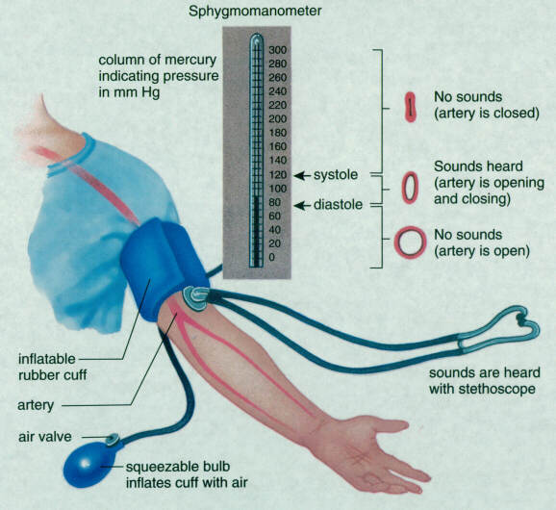
Blood Pressure
Hydrostatic pressure that blood exerts against the wall of a vessel.

Slide 9
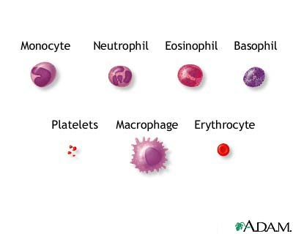
Composition of Blood
*Red Blood Cells – transport Oxygen, biconcave disk (increases surface area) –erythrocyte, no nuclei, no mitochondria (ATP anaerobic metabolism), small
White Blood Cells (Leukocytes) –
(Immune system- defense) 5 major types: monocytes, neutrophils, basophils, eosinophils & lymphocytes
Platelets – no nucleus, not really a cell, help with blood clotting
Pluripotent stem cells- come from
Red marrow of bones (ribs, vertebrae,
Breastbone, pelvis) dev. into any blood
cells

Slide 10
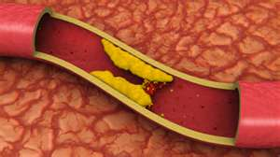
Cardiovascular Disease
Disease of the heart & blood vessels
Heart Attack or Stroke
Atherosclerosis – blood clot plugging an artery
Plaques – growths develop on the inner walls of arteries
LDL – (bad Cholesterol) cholesterol travels in blood bound to protein and adds plaque to arteries.
HDL – (good Cholesterol) reduce the depositing of cholesterol in arterial plaques

Slide 11
Quick Write
Describe some examples for structure and function concerning the circulatory system P. 50 NB.
Veins – valves
Shape of heart
Arteries – flexible
Shape-Red Blood Cells- Concave

