Slide 1
Natural Selection
The Mechanism for Evolution
Quick write (3 minutes):
“Without mutation natural selection cannot occur”
(Please remind me to play the video when you are done writing and we have discussed your answers.)

Slide 2
Review Phylogeny
Panthera leo (lion), Canis latrans (coyote), Panthera tigris (tiger), and Procyon lotor (racoon) are all members of the order Carnivora. Which two members are the most closely related?
Homo is to genus as sapiens is to _____.
What is the relationship between a family and an order?
If two animals are in the same class, what other categories must they share?

Slide 3
Use the descriptions below to classify each organism in the correct kingdom:
a) multicellular, photosynthetic, cell walls of cellulose.
b) Cell wall lacks peptidoglycan, live in extreme environments and survive only in the absence of oxygen.
c) unicellular, eukaryotic organisms with chloroplasts.

Slide 4
II. Natural Selection on Polygenic Traits
Natural selection can affect the distribution of phenotypes in any of three ways:
(1) directional selection
(2) stabilizing selection
(3) disruptive selection.

Slide 5
Foldable Chapter 15 The Theory of Evolution
Types of Natural Selection
Stabilizing Selection
Directional Selection
Disruptive Selection

Slide 6
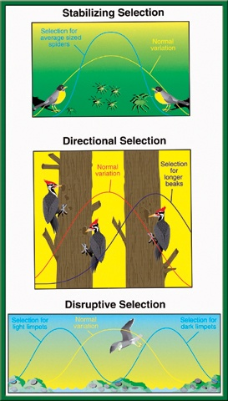
Make a picture
Describe the Selection
Give an Example
Page 115 NB
Types of Natural Selection
To return to the chapter summary click escape or close this document.

Slide 7
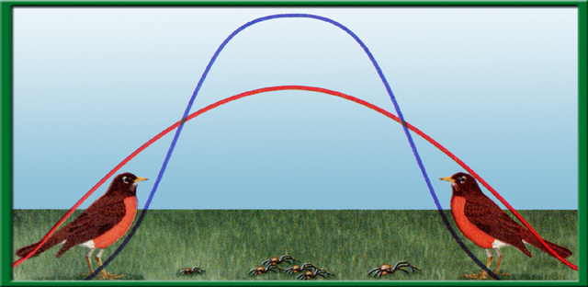
Section 15.2 Summary– pages 404-413
Natural selection acts on variations
Stabilizing selection is a natural selection that favors average individuals in a population.
Selection for
average size
spiders
Normal variation

Slide 8
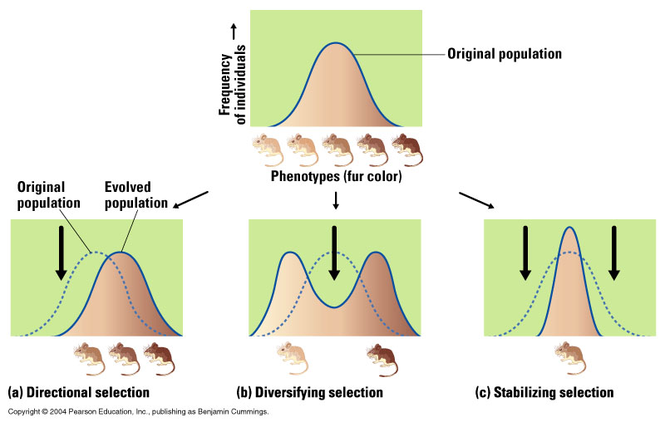
B. Stabilizing Selection
1. Intermediate characteristics are favored.
Examples: Human babies with very high or very low birth weights have lower survival than babies with intermediate weights.

Slide 9
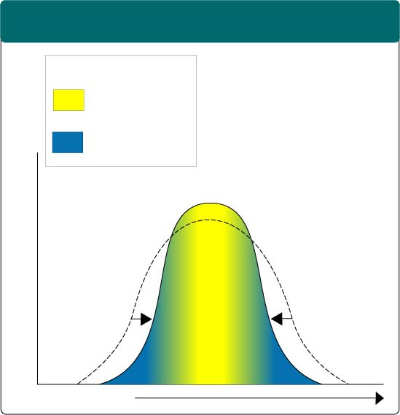
Stabilizing Selection Figure 16–7
Section 16-2
Stabilizing Selection
Selection against both extremes keep curve narrow and in same place.
Key
Low mortality, high fitness
High mortality, low fitness
Sooooo…what does it mean?
Percentage of Population
So average birth weight is most beneficial for a child’s survival.
Birth Weight

Slide 10
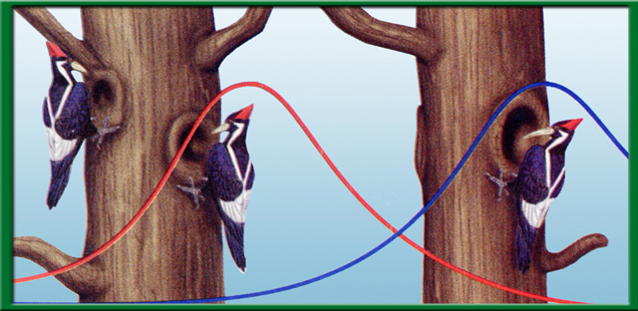
Section 15.2 Summary– pages 404-413
Natural selection acts on variations
Directional selection occurs when natural selection favors one of the extreme variations of a trait.
Selection for longer beaks
Normal
variation

Slide 11
A. Directional Selection
1. One of the two possible extremes is favored.
Example: Dark-colored peppered moths in regions of England with industrial pollution.

Slide 12
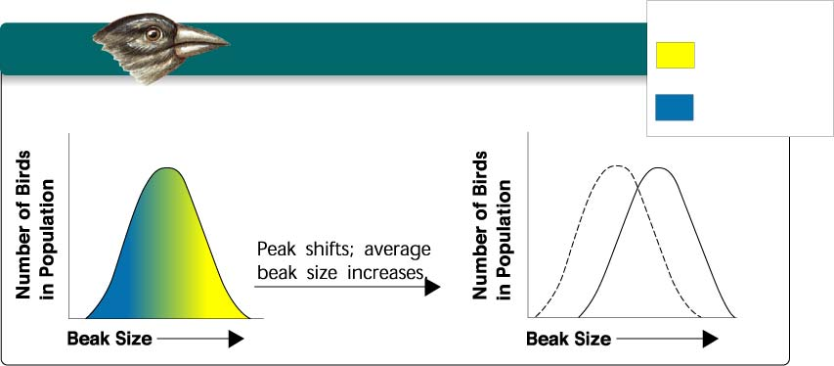
Directional Selection Figure 16–6
Section 16-2
Key
Directional Selection
Low mortality, high fitness
Food becomes scarce.
High mortality, low fitness
Define directional selection based upon what the chart shows.

Slide 13
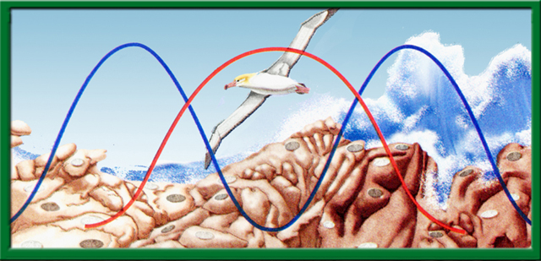
Section 15.2 Summary– pages 404-413
Natural selection acts on variations
In disruptive (diversifying) selection, individuals with either extreme of a trait’s variation are selected for.
Selection for
light limpets
Normal variation
Selection for
dark limpets

Slide 14
C. Disruptive (Diversifying) Selection
1. Natural selection moves characteristics toward both extremes, and intermediate phenotypes become rarest.
Example: Populations of West African birds with either large or small, but not intermediate size beaks.

Slide 15
Disruptive (Diversifying) Selection Figure 16–8
Section 16-2
Disruptive Selection
Largest and smallest seeds become more common.
Key
Low mortality, high fitness
Population splits into two subgroups specializing in different seeds.
Number of Birds in Population
Number of Birds in Population
High mortality, low fitness
Beak Size
Beak Size
So what is being selected for here?
Two different extremes, small and large beaks.

Slide 16
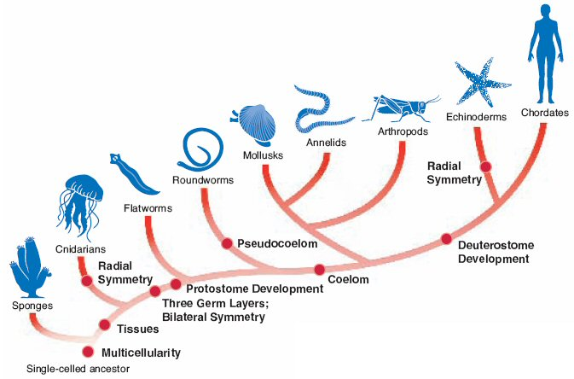
Phylogeny of Humans

Slide 17
Evidence for Evolution
Fossil Record
DNA
Molecular Record
Homology
Embryology
Vestigual Structures
Divergent Evolution
Convergent Evolution
Analogous Functions
Island Pattern of Distribution
Artifical Selection
Miller & Urey Experiment

Slide 18
Complete the following table (you may have to look up some organisms):
Characteristics | Euglena | Mushroom | Crab | Bread Mold | E. coli | Violet | Paramecium | Dog
Unicellular
Multicellular
Autotroph
Heterotroph
Organ systems
Chlorophyll
Cell walls
Walls of cellulose
Walls of chitin
Organelles lack membranes

Slide 19
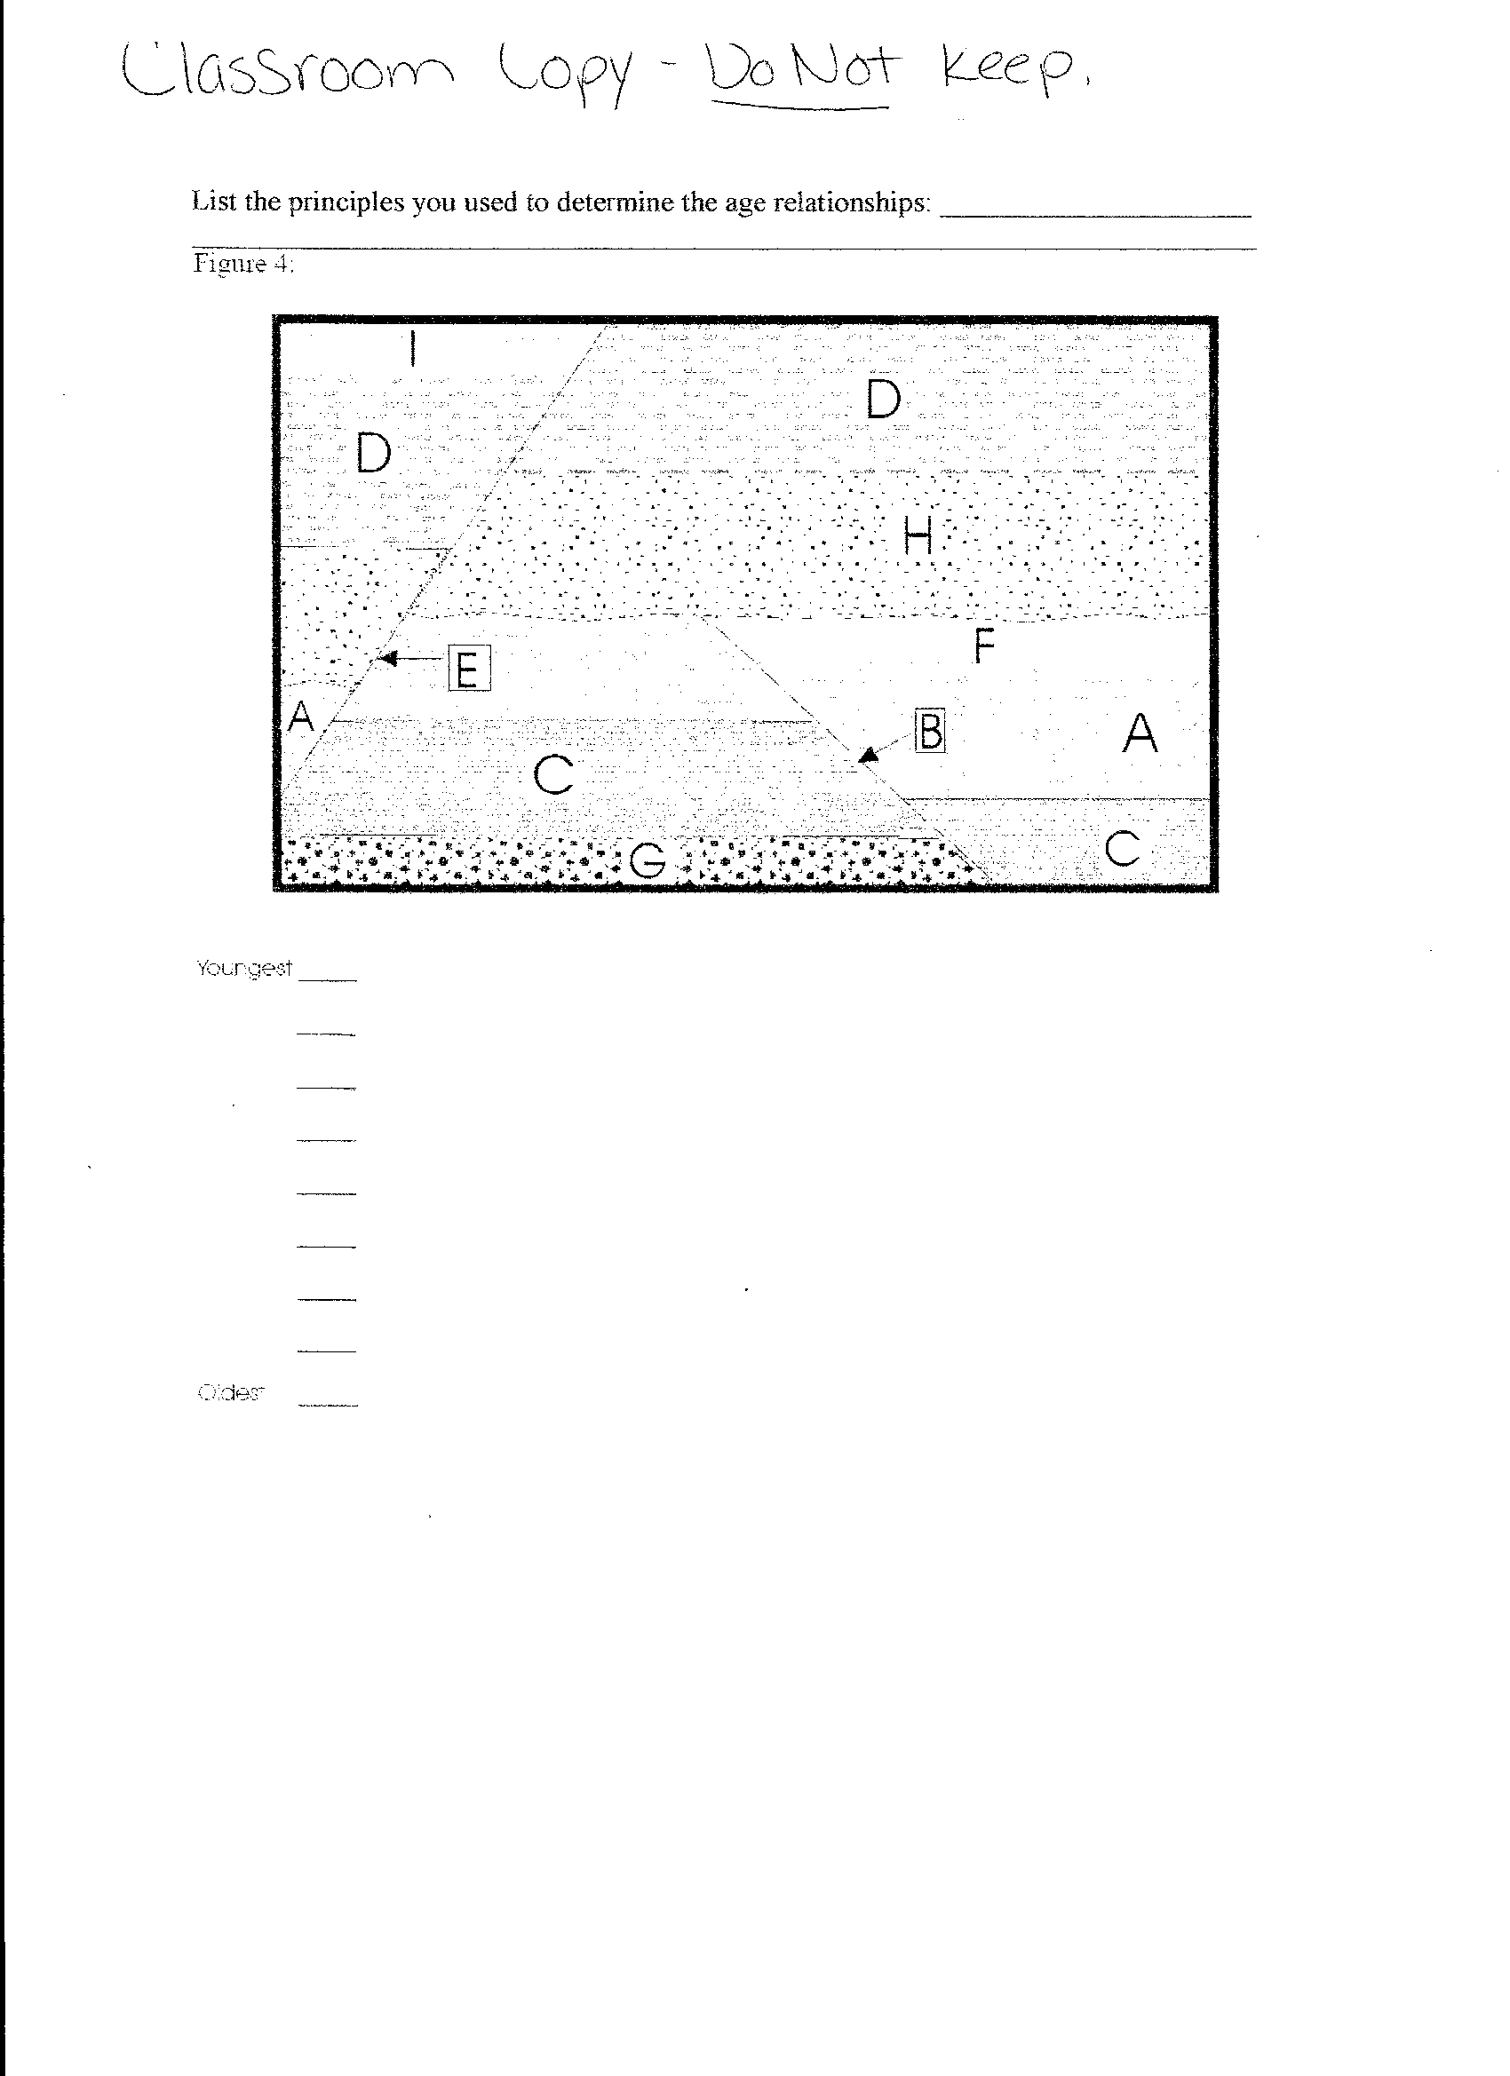

Slide 20
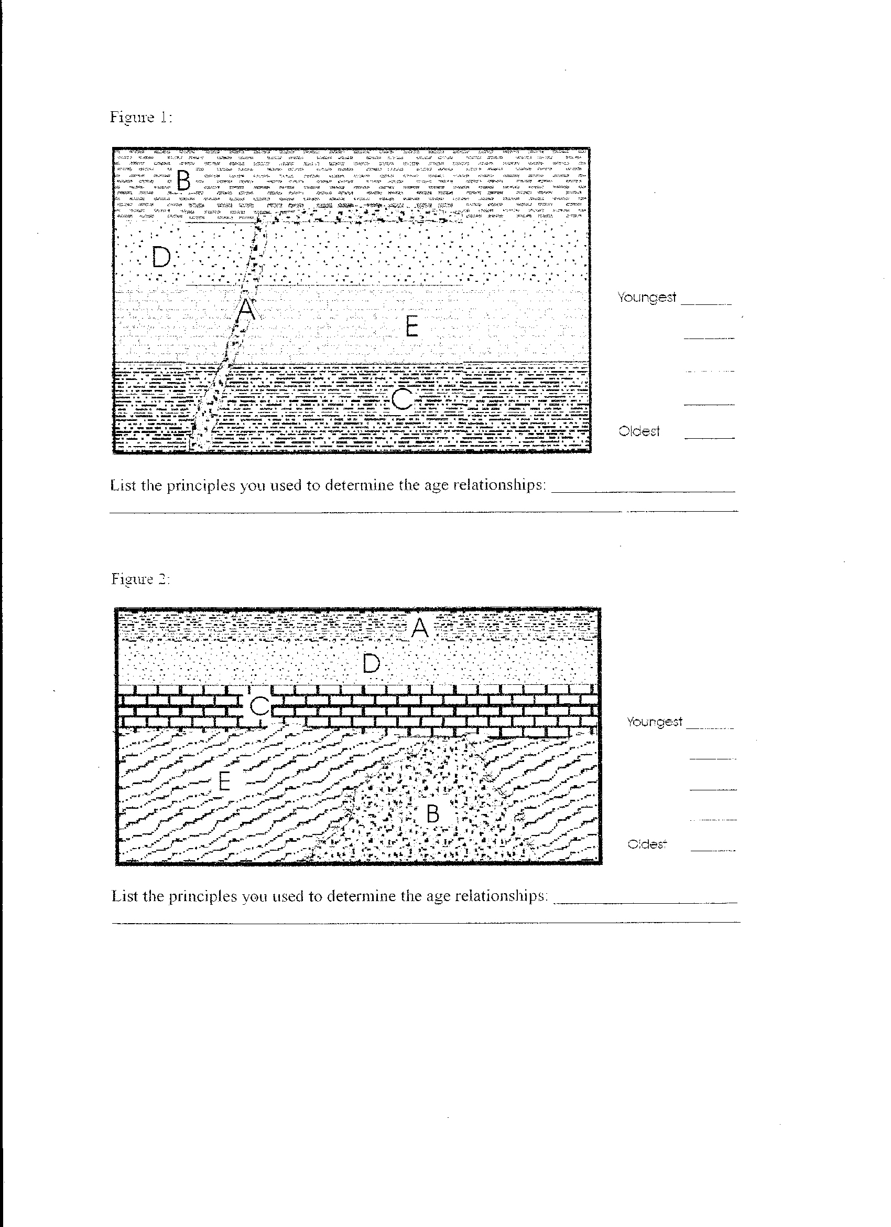

Slide 22
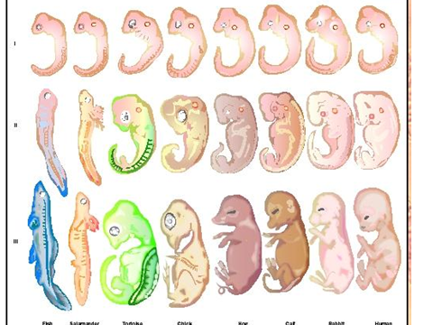
Embryology

