Slide 1
Day 2 of AP Review
AP Biology Vocabulary Mania
Get a flash card and quiz at least three people then have a seat to start your quick write.

Slide 2
Quick write
Continuity and Change—All species tend to maintain themselves from generation to generation using the same genetic code. However, there are genetic mechanisms that lead to change over time, or evolution.
Example: Mitosis consistently replicates cells in an organism; meiosis (and hence sexual reproduction) results in genetic variability.
Comment (discuss) on either of the first two examples or come up with one or two more examples of continuity & change and discuss how they relate to continuity & change.

Slide 3
Review lab #2 Enzyme Catalysis
What was the enzyme?
What was the substrate?
What was the product in the reaction?
How could you prove that the gas emitted was O2?
If you were to draw a graph, what would be the independent variable and the dependent variable?
How would you title it?
What was the best temperature? Why?
What was the best enzyme & substrate concentration? Why?

Slide 4
Review Lab #3 Compare & Contrast Mitosis & Meiosis
Mitosis
Formation of new cells genetically identical to parent cell
New somatic cells for growth and repair
Formation of adult from zygote
Asexual reproduction in unicellular organisms
Regeneration
Meiosis
Reduction of chromosome number
Formation of gametes in animals
Formation of spores in plants

Slide 5
Mitosis
Prophase – duplicated homologous chromosomes do not pair to form tetrads, & crossing over between homologous chromosomes does not occur
Metaphase – individual chromosomes align independently of one another at the metaphase plate.
Anaphase – Sister chromatids of each duplicated chromosomes stay together and homologous pairs of chromosomes separate. Homologous chromatids are separted during the meiotic division.

Slide 6
Meiosis
Prophase I – duplicated homologous chromosome pair to form tetrads, and crossing over does occur between homologous chromosomes.
Metaphase I – tetrads align at the metaphase plate.
Anaphase I – sister chromatids of each duplicated chromosome stay together and homologous pair of chromosomes separate. Homologous chromatids are separated during the second meiotic division.

Slide 7
Comparing Mitosis & meiosis
 | Mitosis | Meiosis
Chromosome Number of Parents | 2N | 2N
Number of DNA Replications | 1 | 1
Number of Divisions | 1 | 2
Number of Daughter Cells Produced | 2 | 4
Chromosome Number of Daughter Cells | 2N | N
Purpose/ Function | Growth, Repair, Replace | Formation of gametes and spores

Slide 8
Fetal Pig Dissection
Continuity & change
Both the Fetal Pig and humans have DNA, but DNA is coded differently to produce different proteins.

Slide 9
Good Review Study Questions
The continuity of life is based on heritable information in the form of DNA. In a short essay (100 – 150 ) words, explain how the process of mitosis faithfully parcels out exact copies of this heritable information in the production of genetically identical daughter cells.

Slide 10
The continuity of life is based on heritable information in the form f DNA. In a short essay (100 – 150 words), explain how chromosomes behavior during sexual reproduction in animals ensures perpetuation of parental traits in offspring and , at the same time, genentic variation among offspring.

Slide 11
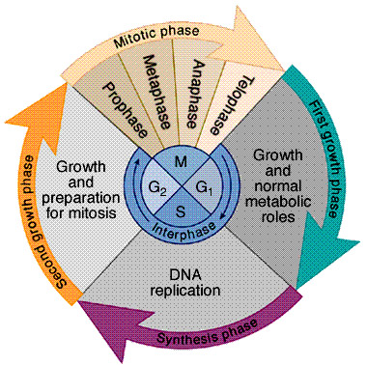
Cell Cycle
Check points exist at G1, G2 & M.
A checkpoint is a control point
where the signals for stop and
go – ahead regulate the cycle. These
signals report whether important
cellular processes have occurred by that point in the cycle.
G₀ phase is the non-dividing state where the cell exits the cell cycle
Cells in the body that are in G₀ phase are the nerve cells and muscle cells that never divide.

