Slide 1
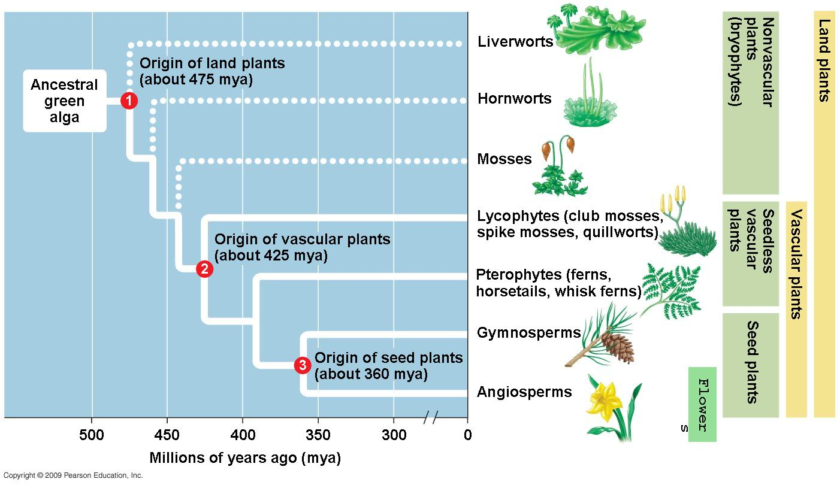
CH 29 How plants colonized the land, 30 Evolution of seed plants, 35 Plant Structure & Growth
11/7 Obj. TSW demonstrate understanding of how plants photosynthesize by performing the leaf disk assay lab.

Slide 2
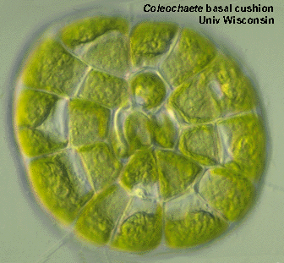
Plant characteristics
Multicellular, eukaryotic, photosynthetic autotrophs,
cells walls –cellulose and Chlorophylls a & b, monophyletic
Charophyceans- closest algal relative to plant kingdom, inhabited shallow waters around edges of ponds and subject to occasional drying
  Homologous chloroplasts
  Cellulose microfibrils of cell walls
  Enzymes – peroxisomes (associated with chloroplasts
  Flagellated sperm cells
  Cell division – formation of cell plate (phramoplasts)
  Ribosomal RNA & chloroplast DNA connect Charophyceans to plants
Apical Meristems – localized regions of cell division at the tips of shoots and roots
Multicellular dependent embryos – derived characteristics to land plants

Slide 3
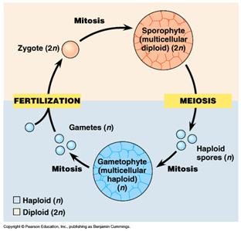
Alternation of generation:
Gametophyte (haploid) & sporophytes (diploid)
  Meiosis in the sporophytes produces haploid reproductive cells – spores
  Spore can develop into a new organism (gametophyte) w/o fusing with a another cell
  Mitotic division of the spore produces a new multicellular gametophyte that produces gametes that unite to form the zygote that develop into a sporophyte

Slide 4
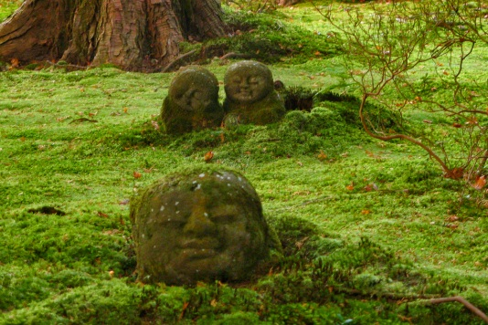
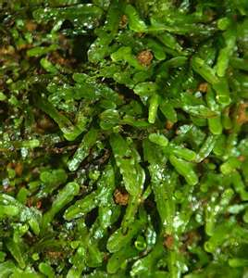
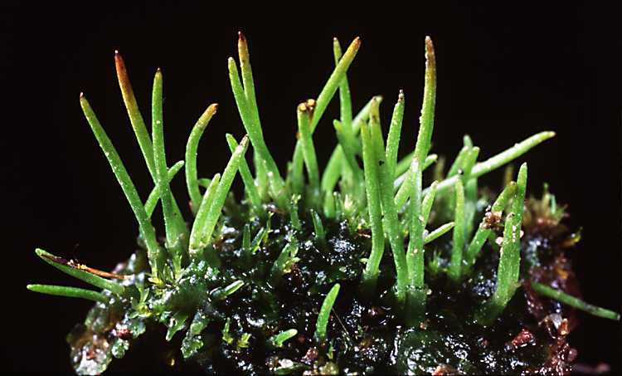
Four main groups of land plants:
Bryophytes, Pteridophytes, gymnosperms, Angiosperms, (10 plant phyla)
Bryophytes – mosses, liverworts, hornworts
  Have reproductive adaptations different from algae
  Offspring develop from multicellular embryos that remain attached to the “mother” plant, which protects and nourishes the embryo.
  Lack vascular tissue, but do have water conducting tubes
  No true roots, stems or leaves
  Dominant generation: gametophyte form
  Dispersal of spores by wind

Slide 5
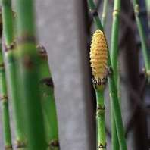
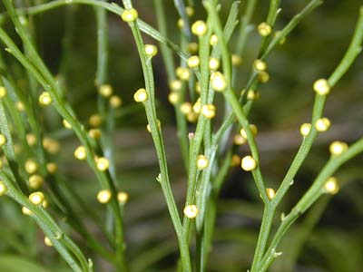
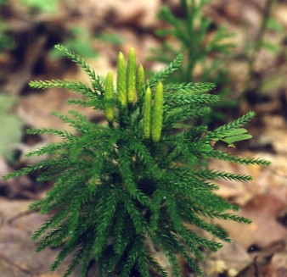
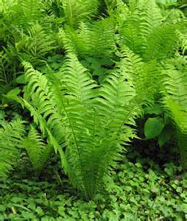
Pteridophytes
Lycophytes (Club Moss), Pterophyta (ferns, whisk ferns, horse tails)
Vascular tissue, but no seeds
  Cells are honed into tubes that transport water and nutrient throughout the plant body
  Xylem – transport water
  Phloem – transports sugar
Sporophyte generation – dominant form

Slide 6
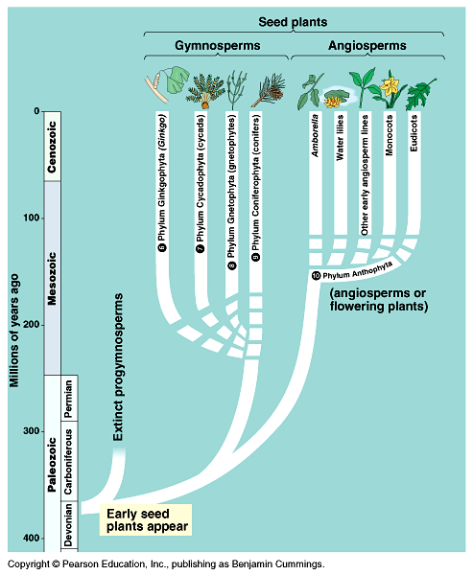
Gymnosperms- naked seed (Conifers)
Vascular and seeds (facilitating reproduction on land), cone bearing
360 million years ago
  Sporophyte generation – dominant form
  Transfer of pollen to the ovule – Pollination
  4 Phyla of gymnosperms
    Ginko-fan-like leaves, deciduous
    Cycads- resemble palms
    Gnetphytes- shrub-like
    Conifers –pine trees, redwood

Slide 7
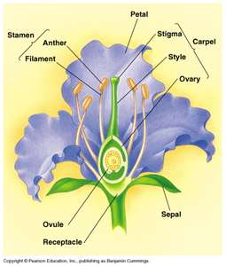
Angiosperms
Vascular, seeds and flowering plants
130 million years ago
Protective coat and ovary around seed- fruit
  (protects the seed, helps it get eaten and carried to a different place to decrease competition with parent plant
  Sporophyte generation – dominant form
Monocots(one cotyledon - corn), Dicots (two cotyledon - bean)
Coevolution – Angiosperms & animals
  Flying insects – pollination (creates diversity of flowers)
Agriculture – fruit & vegetable crops: corn, rice, wheat (selective breeding- artificial selection)
Sustainability – plant diversity – nonrenewable resource, extinction of plant species and animals that depend on them
  Available medicines
  Available resources – housing
  Economy- jobs - balance

Slide 8
Complete Flower

Slide 9
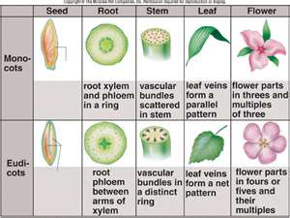
Plant structure & growth
Roots, Stems Leaves - organs
Hierarchy of structural levels: multicellular organism, consisting of organs composed of tissues, with different types of cells
Monocots – fibrous root system
Dicots – taproot
Root hairs- increases the surface area to absorb water and minerals and anchor the plant
Stems – have nodes – give rise to leaves
Leaves – main photosynthetic organ

Slide 10
Plant organs: 3 tissues- dermal, vascular & ground
Dermal – epidermis, single layer of tightly packed cells that covers & protects all young parts of the plant.
  Also have specialized characteristics consistent with the function
    Ex. Leaves – cuticle (waxy) to reduce water loss
    Roots – root hairs, to increase water absorbtion
Vascular
  Xylem – moves water and dissolved minerals upward
  Phloem – transports food made in leaves to roots and developing leaves and fruits.
Ground
  Photosynthesis, storage, and support
  Pith- internal to vascular tissue
  Cortex – external to the vascular tissue

Slide 11
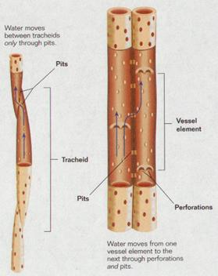
Plant Cells
Xylem- Tracheids – water transport
  Vessel element – transports water, but the cell itself is dead at maturity
Phloem - Sieve- tube members -Sucrose transportation
    Lack a nucleus, ribosomes, and distinct vacuole
  Sieve plates – end walls between sieve tube members
  Companion Cell – along side the sieve tube member, help load sugar produced in the leaf. It does have a nucleus and ribosomes that serve the adjacent sieve-tube member.
Parenchyma – “typical” plant cell, not specialized, primary walls, thin and flexible, large central vacuole. It performs metabolic functions for the plant (photosynthesis)
Collenchyma – thicker primary walls, uneven, help support young parts of the plant (celery stalk), provide support
Sclerenchyma – occur in regions of the plant that have stopped growing, thick secondary wall, do not elongate

Slide 12
Alternation of Generations P. 27
With the following cards, place them in order and write the order in your notebook. You have three minutes… GO!
Meiosis, Mitosis, Gamete, Spore, Fertilization, Sporophyte, Gametophyte, Zygote
P. 611 Life cycle of an angiosperm
Sporophyte (2n) →meiosis → spore (2n) → gametophyte (n)→gametes (n) → fertilization → zygote→ mitosis → Sporophyte

