Slide 1
SUICIDE NOTES

Slide 2
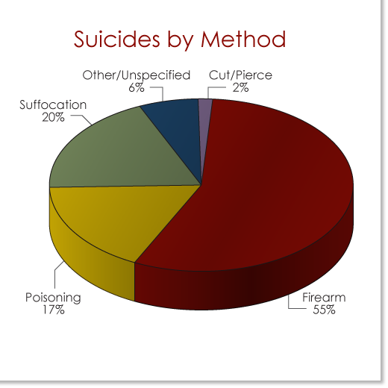
Suicide Facts
5,000 teenage suicides per year in US=14 per day
50,000 teens attempt each year=10% HS students
50% high school students have planned how
More females attempt-more males succeed

Slide 3
DEPRESSION: feeling of sadness, little self-worth, no hope or joy, helplessness
Symptoms include:
Drop in grades
Isolating from friends/family
Personality changes
No energy
Loss of interest in activities
Under/over eating
Sleeping too little/much
Change in appearance

Slide 4
STUDENTS WHO ARE AT RISK are those who:
Previous attempts
Low self esteem/poor mental health
Traumatic family events
Have poor social health or are in trouble with family, school, peers, or the law
Drug/alcohol abusers
Have been abused, neglected, or molested
Feel discriminated-handicapped, minority, poor, feel alone
perfectionists

Slide 5
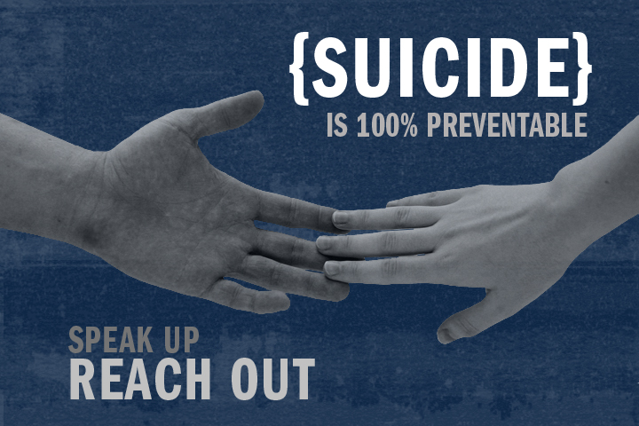
WARNING SIGNS
Threats or talking about it
Symptoms of depression
Wreckless behavior
Making final plans/giving away possessions
Uncontrolled crying or sudden unexpected happiness

Slide 6
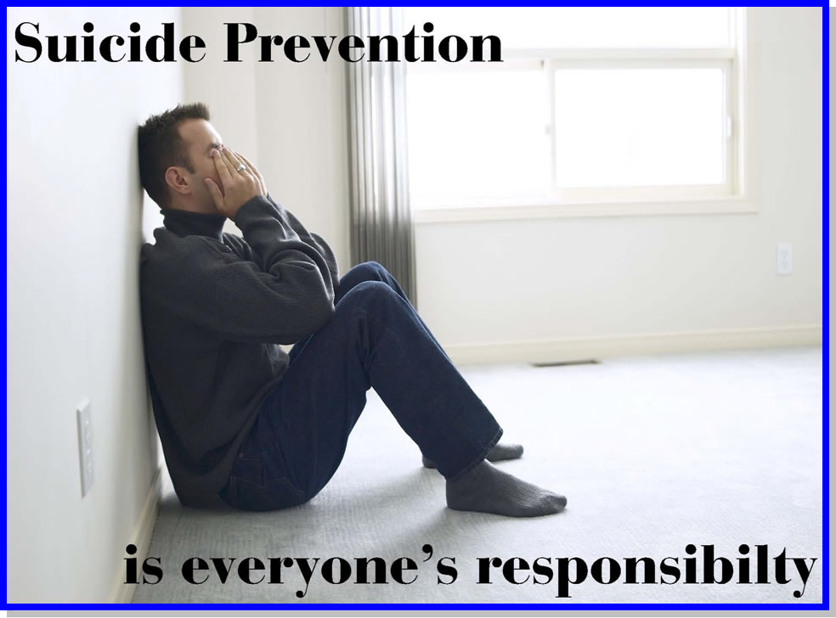
Prevention

Slide 7
HOW TO HELP A SUICIDAL FRIEND
If a friend tells you that he or she is thinking of suicide:
Ask questions about their feelings
Listen to what is said
Encourage your friend to get help
Talk to a trusted friend
Call crisis line for help

Slide 8
DO NOT
Keep it a secret
Assume they want attention
Ask why
Dare or challenge them

Slide 9
24 Hour Crisis Line:
Davis (530) 756-5000
West Sacramento (916) 372-6565
Woodland (530) 666-7778

