Slide 1
Types of
Relationships

Slide 2
There are four different categories of relationships:
Family
Friendship
Dating
Marriage

Slide 3

Family
Through relationships with family members, a child learns love, respect, getting along well with others, and to function as part of a group.

Slide 4
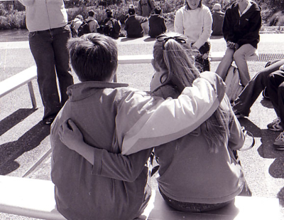
Friendships
Relationships with friends are give and take. They are based on mutual trust, acceptance, common interest and common value.

Slide 5
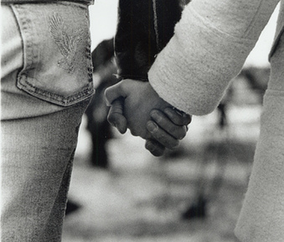
Dating
Dating is the typical way by which teenagers get to know people whom they are attracted to.

Slide 6
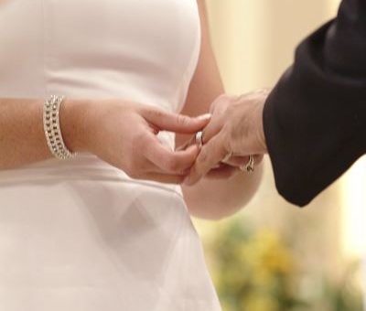
Marriage
People marry for love, companionship, financial and social reasons, and/or to start a family.

Slide 7
Types of Relationships

Slide 8
Family
Nuclear: A family with a mother father and children, who all live together.
Single Parent: A mother or father that doesn’t have a partner and lives with only their children.
Extended Family: When a nuclear or single parent family lives close or with other relatives.
Blended Family: When a single parent remarries. A blended family consists of a biological parent and a non-biological parent.
Foster Family: When an adult or couple provides a home and care for a child, because the child’s biological family cannot care for them.
Other Family: When a married couple doesn't have kids OR when an unrelated group of people live together and support one another as if they were a family.

Slide 9
Friendships
Casual: These are convenient friends, whom you may have in a class and be assigned a project with or a neighbor you say “Hi” to.
Close: In other words: A best friend. This is someone you can talk to about a problem or just someone that you love to hang out with. A close friend is someone that you want to be friends with for a very long time, or forever.
Opposite Sex: When a boy and a girl are friends. Many people have opposite sex friends because they have similar interests.

Slide 10
Dating
Casual: When you are in a relationship with someone you like. You are not sure if they will be “the one,” and you see them on occasion.
Steady: When you are in a relationship with someone you feel that you are in love with. This someone is very special to you and you always want to be around them.

Slide 11
Marriage
Successful: A successful marriage entails the following:
  Love
  Compatibility
  Friendship
  Similar interests backgrounds and goals
  Strong commitment to one another
  Communication
  Shared responsibilities
  Physical attraction
  Mutual concern and respect
  Ability to compromise

