Slide 1
Espanol 4

Slide 2
Despegue:
What do you like to be called?
What is your biggest pet peeve?
What are your goals for this class?

Slide 3
Programa de curso y reglamento

Slide 4
Day 2: Student expectations
Be respectful
Be prepared
Be present
Be on time
Set goals and complete work with integrity
Participate
Have an open mind
Required materials: Notebook, pens/pencils, paper, white board marker, and tape or glue.

Slide 5
R-E-S-P-E-C-T
Biggest classroom rule: RESPECT ONE ANOTHER
Define RESPECT in your own words.
Everyone has the right to education in our country.
No one has the right to take it away from you.

Slide 6
Group Discussion:
In groups of three, discuss the essential questions.
Designate a note-taker and a speaker.

Slide 7
Essential questions and importance of learning Spanish:
What are the benefits and personal gains of speaking another language?
How does culture shape language and language shape culture? What are some examples?
When does one become fully proficient in a language?
How can I communicate effectively with the Spanish I already know?

Slide 8
Assessment

Slide 9
¡Todo sobre ti!

Slide 10
Despegue: Traduzcan al inglés.
No entiendo la lección.
¿Por qué no quieres ir al cine?
¿Cuántos alumnos hay en la clase?

Slide 11
Classroom policies and procedures:
Teacher Contact info
Course description
Materials
Student responsibilities and expectations
Despegues/Aterrizaje
Homework/Academic Outreach
Participation
Bathroom pass /sign out policy
Test/Quiz policy

Slide 12
Student Jobs:
Escribir fecha (1st period): Changed the date
Repartir papeles: hand out papers
Devolver papeles: returned graded papers
Recoger papeles: pick up papers (to be turned in)
Repartir pizarrones y borradores: distribute white boards and erasers.
Embajador: Ambassador (greets visitors)
Portero: Doorman (shuts the door and controls lights directed by Teacher)
Students who participate in the jobs with receive extra bathroom passes each month.
If you are ‘’fired’’ from the job because you fail to perform the task, you may lose participation points.

Slide 13
Your notebook:
1. Should be kept in chronological order.
2 First page should be ‘’Frases utiles’
3.Take notes in an organized format (write what you see on the board) or paste in note handouts.
Recycle paper, write notes or do activities on the same page if possible. Remember to date and title all activities.

Slide 14
Competencia:
How do you earn participation points?
How can you lose participation points?
When is Mrs. Nieves available after class?
Where did Mrs. Nieves graduate from?
What is the consequence after a verbal warning?
What are two of the student expectations and responsibilities?
What is respect?
How do you learn a language?
What are some activities we will do in this class?

Slide 15
Spanish-speaking country trivia
Kahoot!

Slide 16
REMIND APP
Spanish 1

Slide 17
Repaso/Práctica (superverbs)
Hay/ Había/ Hubo
Es/era/fue
Está/estaba/estuvo
Tiene/tenia/tuvo
Quiere/quería/quiso
Va a/iba a/ fue a
Le gusta/le gustaba/ le gusto
Números 1-100
There is/ There was/ There was
He/she is / was / was
He/she is / was / was located or feeling
He/she has / had / had
He/she wants / wanted /wanted
He/she goes to / was going / went
He/she likes / liked / liked

Slide 18
Práctica: Madlibs
Había una vez un __________ (persona/animal) que se llamaba ____________ (nombre). ______________ (nombre) tenía _______ (#) años y era muy ___________ (descripción).
Muchas veces ___________ (nombre) iba a __________ (lugar). Pero un día, no quería. Entonces, _________ (nombre) fue a ____________ (otro lugar). Cuando estaba en ___________ (lugar) ____________ (verbo) y ______________verbo. Se divirtió mucho en ____________________ porque le gustaba _______________ (verbo).
De repente, empezó a __________ (verbo). ¡Ay no! ¡Pobre _______ (nombre)!

Slide 19
Despegue: Traduzcan
No hay muchos alumnos en la clase.
Ayer hubo un examen.
Ella va al centro comercial porque le gusta ir de compras.

Slide 20
Syllabus quiz – True or False
1. Students earn participation points by being actively engaged in a lesson.
Students lose participation points by distracting other students.
Students may use their phones during class.
Students may jokingly name-call each other.
Students will reflect on their learning in the ‘’Aterrizaje’’ or cool down.
A morpheme is a part of the word such as a suffix or prefix that has a certain meaning.
Some of the students’ responsibilities are to arrive on time, be prepared for class and to respect the classroom rules.
Students receive three bathroom passes a year.
Students should interrupt the teacher if they need to use the bathroom.
There will be a test every week without any re-takes.

Slide 21
Mini competencia:
Ayer hubo una tormenta y llovió mucho.
Cuando Karolena era niña, tenia 2 perros.
Los alumnos tienen cuadernos en sus mochilas.
Fernando quería nadar en la piscina.
Mi mamá está ayudando a mi abuela preparar los tamales.
A Catalina le gusta comprar ropa en el centro comercial.
El hipopótamo era feo y gordo y siempre quería comer helado/
El niño no quiere ir a la fiesta porque no le gusta bailar, prefiere ver la tele.
Mañana es viernes y voy a ir al cine.
Mis compañeros de clase no hablan mucho.
Ayer Carlos estaba enfermo y se quedó en casa.

Slide 22
My 7 minute story
Now tell me your story

Slide 23
Despegue:Respondan a las preguntas
¿Cuál es tu clase favorita? ¿Por que?
¿Por qué estudias español?

Slide 24
Describan la foto

Slide 26
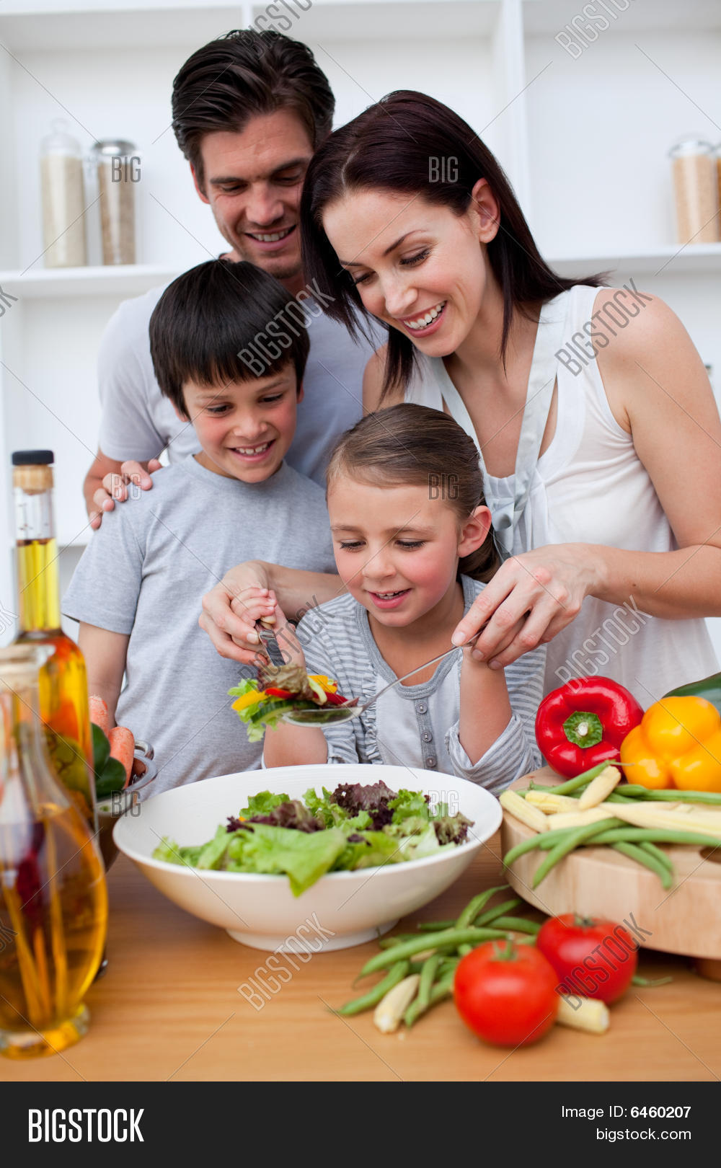

Slide 27
Despegue: Describan la foto en 3 frases.

Slide 28
Movie Talk ‘’Alike’’ ppts

Slide 29
El Nuevo Houdini PPT

