Slide 1
Bienvenidos a la clase de español 1
Srta. Nieves

Slide 2
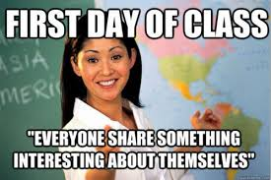

Slide 3
¿Por qué hablar el español?

Slide 4
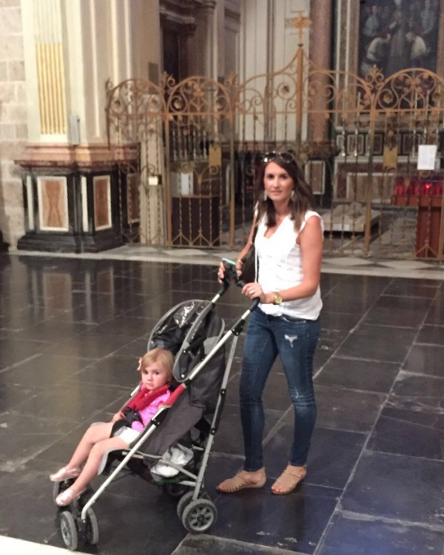
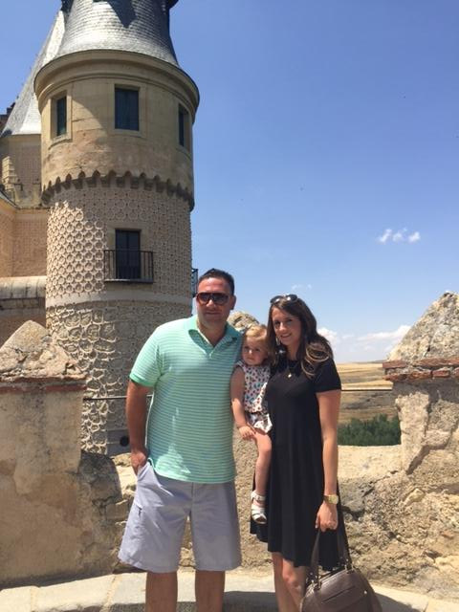
Who am I?
Spanish Teacher (8th year)
Spanish/ American
Graduate from the University of California, Davis
Family
Loves to…
travel, spend time
with family, listen to all types
of music, read, try new
foods, learn about different
cultures.
Multicultural Club co-advisor
And Student Senate Advisor.

Slide 5
Why am I qualified:
Family from Madrid, España. Spent a year studying and working in Madrid. Studied language, Spanish literature, history, and culture.
Graduated from UCDavis with a Bachelors in Spanish Language
Earned Single-subject (Spanish-World Languages) teaching credential at CSUS with a supplementary credential in English.
8+ years of experience teaching.

Slide 6
Name Tent:
Write your preferred name ‘’front’’ of the name tent’’.
Draw four symbols or drawings that you would say you most identify with or enjoy doing.
Write your full name somewhere on the back. (First and Last names)

Slide 7
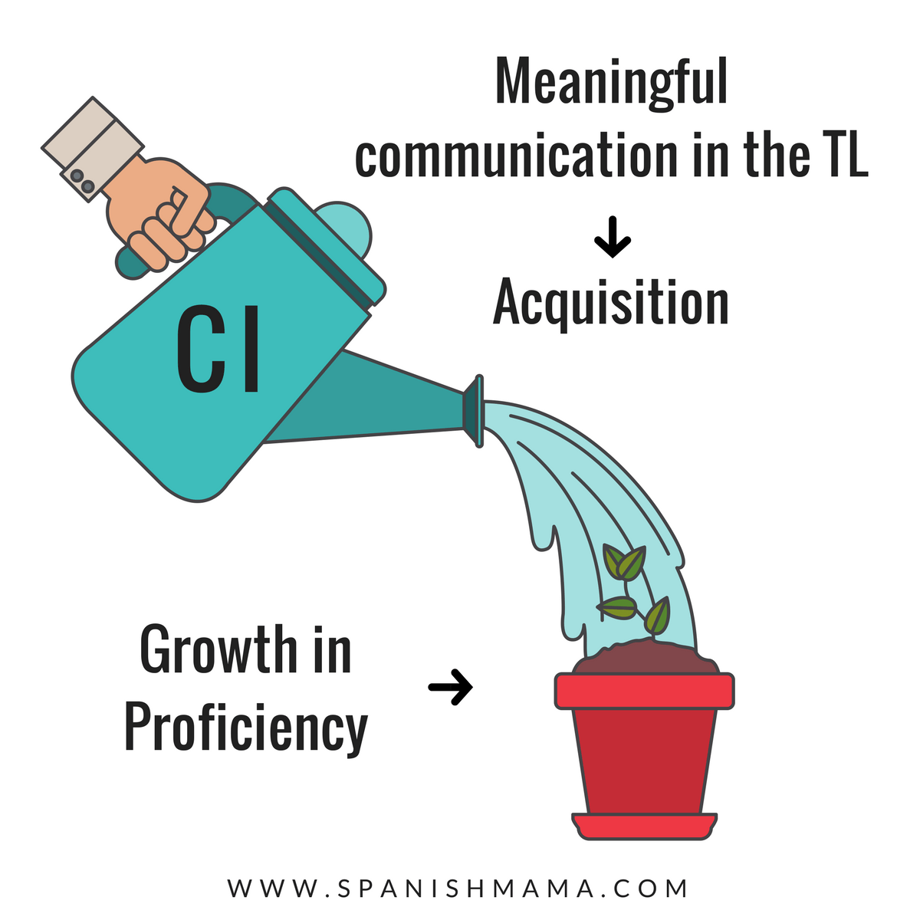
New curriculum adoption
Immediate Immersion
90% speaking in the target language.
Focuses on communication through comprehensible input.

Slide 8
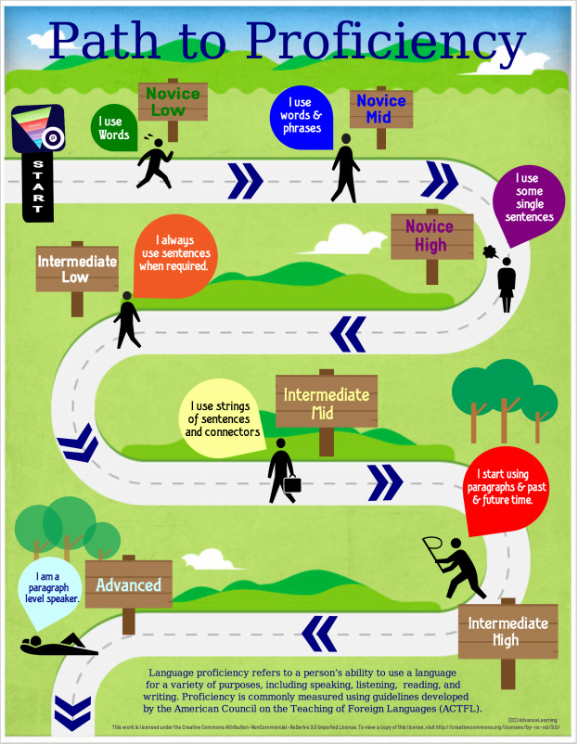
PROGRESS
NOT
PERFECTION!

Slide 9
Student expectations
Be respectful
Be prepared
Be present
Be on time
Set goals and complete work with integrity
Participate
Have an open mind
Required materials: Notebook, pens/pencils, paper, white board marker.

Slide 10
4 corners
Listen to the options.
Go to the corner that you most agree with.
Talk with the people that are in your corner.

Slide 11
During the break I…
1. had to work
2. watched a lot of TV or played videogames.
3. traveled somewhere.
4. went shopping.

Slide 12
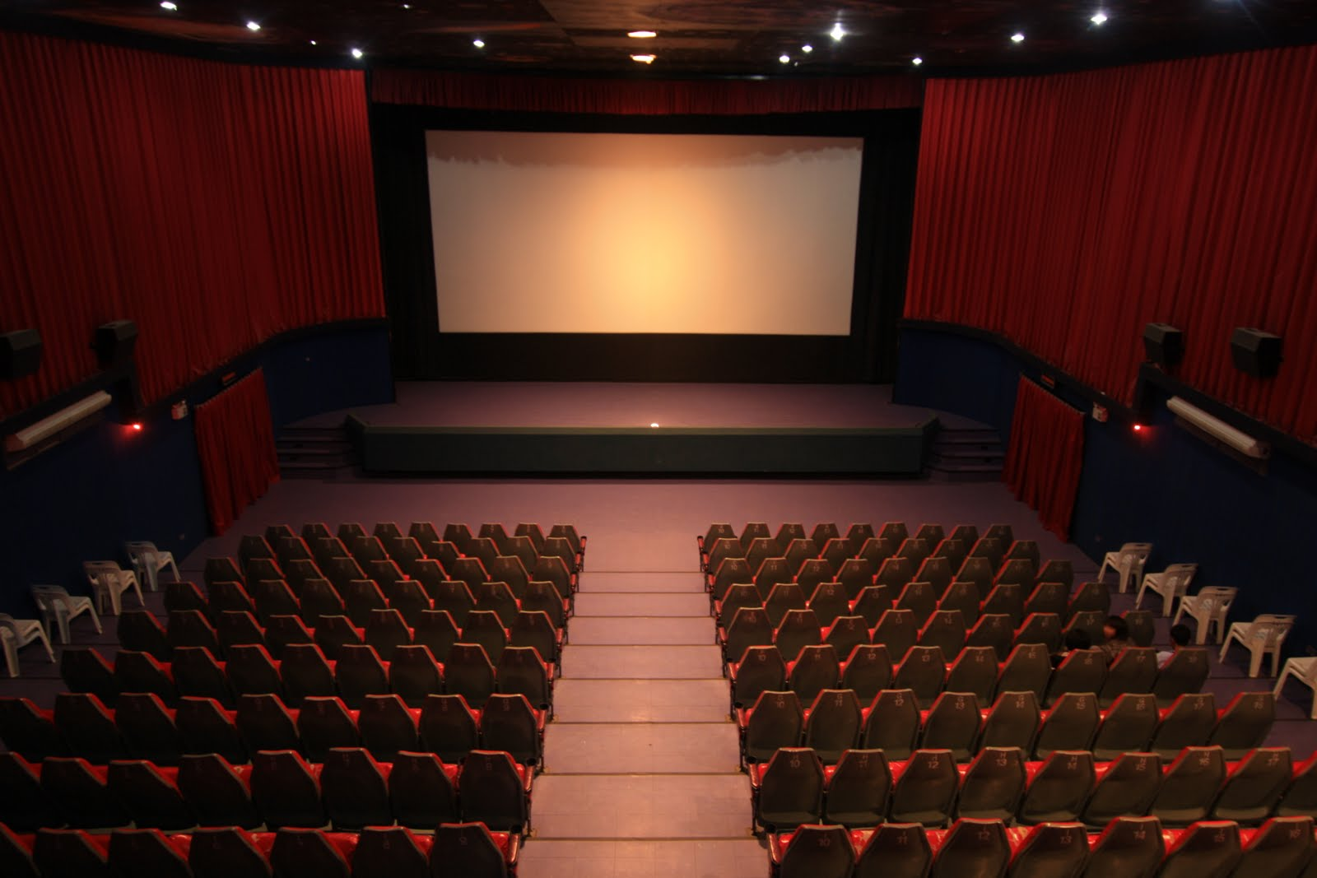
I would rather watch…
A romantic movie.
A sci-fi movie.
A horror movie.
A comedy.

Slide 13
I like…
Snapchat
Pinterest
SportsCenter app
Instagram

Slide 14
My dream vacation is…
A cruise to Alaska.
A Caribbean get-a-way.
Backpacking through Europe.
An African Safari.

Slide 15
I have a…
Dog or a cat
Both dogs and cats
Farm animals
No animals

Slide 16
I would rather listen to..
Rap and hip hop music
Country Music
Classical
Pop music

Slide 17
I would rather be…
An English teacher
A graphic designer
An engineer
A radiologist

Slide 18
I like to read…
Online articles
Comic books
Non-fiction
Sci-Fi

Slide 19
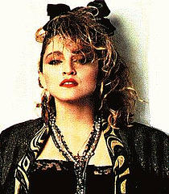
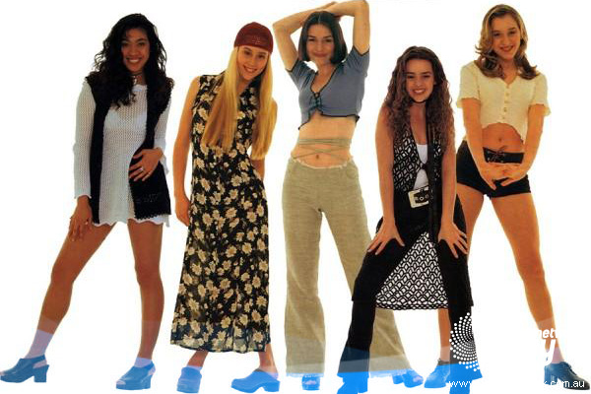
If I could dress as my favorite decade it would be…
60s
70s
80s
90s

Slide 20
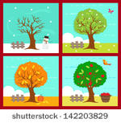
I prefer
Summer
Winter
Spring
Fall

Slide 21
I…
Was born in another country
Was born in another State
Have lived in another region of California.
Have lived in Sacramento my whole life.

Slide 22
Why is google translate not good enough?

Slide 23
Warm-up DESPEGUE (Day 2): On a piece of paper
Nickname/preferred name
Email address
Biggest pet peeve
Favorite app on your phone
Fun fact about yourself
Ethnicity you most identify with
When you can use your Spanish.

Slide 24
Don’t worry!
It doesn’t count! :)
On the same paper of your warm-up, make a list of any Spanish words that you know (please don’t copy anyone or from around the room unless you already know them).
You will have five minutes to complete your list.
Be sure to put your name on your paper!!
Pre-Test

Slide 25
Day 2: Student expectations
Be respectful
Be prepared
Be present
Be on time
Set goals and complete work with integrity
Participate
Have an open mind
Required materials: Notebook, pens/pencils, paper, white board marker

Slide 26
R-E-S-P-E-C-T
Biggest classroom rule: RESPECT ONE ANOTHER
Define RESPECT in your own words.
Everyone has the right to education in our country.
No one has the right to take it away from you.

Slide 27
Group Discussion:
In groups of three, discuss the essential questions.
Designate a note-taker and a speaker.

Slide 28
Essential questions and importance of learning Spanish:
What are the benefits and personal gains of speaking another language?
How does culture shape or influence a language? What are some examples?
When does one become fully proficient in a language?
How can I communicate effectively with the Spanish I already know?

Slide 29
El mundo hispano:
What are the Spanish-speaking countries?
With your shoulder partner, write down a list of all the Countries that speak Spanish that you know about.

Slide 30
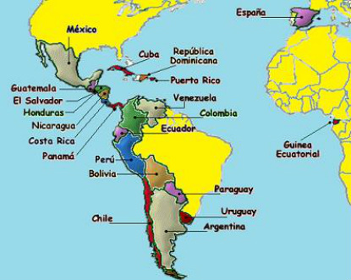

Slide 31
Spanish-speaking country trivia
Kahoot!

Slide 32
Frases útiles
Repitan las frasen útiles.

Slide 33
Day 3: What I need to know about you. Answer the questions on a piece of paper.
1. Define respect in your own words.
2. Describe what it looks like when you learn a language.
3. What are some ways you can improve your language skills?

Slide 34
Grade weight categories:

Slide 35
Classroom policies and procedures:
Teacher Contact info
Course description
Materials
Student responsibilities and expectations
Despegues/Aterrizaje
Homework/Academic Outreach
Participation
Bathroom use/sign out policy
Test/Quiz policy

Slide 36
My 7 minute story

Slide 37
Now write me a letter, telling me your story.

Slide 38
DAY 4: Despegue
On Mondays, grab a green ‘’’Despegue’’ Paper
Write the ‘’Frase Secreta’’
Write the Fecha
Write the Morfema
1. What are some ways to be successful in a language class?

Slide 39
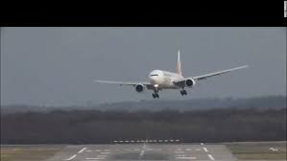
Aterrizaje
Daily reflection
You must leave a comment. (required not optional)
Reflexión de la semana= Last reflection of the week and there will be a question on Fridays.

Slide 40
Morfema
Morphemes are a part of a word like prefixes, suffixes, and roots.
Each day there will be a word of the day based on the week’s morpheme. During warm-up write it down and its meaning.
Example,
Fac/fact= to make
Fácil= easy

Slide 41
Voice equity
Choral response vs. individual response
Choral response involves all students and is prompted by the teacher. Individual response means students raise hand and are called on by teacher to take turns on answer questions. These allow for VOICE EQUITY.
Práctica:
¡Buenos días, clase!
¿Quién es la profesora de español?
Clase, ¿Cómo están?
¿Cuál es la fecha de hoy?
¿Cómo se llama tu hermano?
Clase, ¿Cuál es la mascota de la escuela de River City?

Slide 42
Student Jobs:
Escribir fecha (1st period): Changed the date
Repartir papeles: hand out papers
Devolver papeles: returned graded papers
Recoger papeles: pick up papers (to be turned in)
Repartir pizarrones y borradores: distribute white boards and erasers.
Portero: Doorman (shuts the door and controls lights directed by Teacher)
Volunteers for student Jobs: Students who participate in the jobs with receive extra points in participation.

Slide 43
The student’s job is to…
Listen to understand
Ask questions when you don’t understand
Tell Teacher to slow down ‘’Despacio’’

Slide 44
The teacher’s job is to…
Speak slowly and use language that is understandable.
Repeat when not understood.
Check for understanding frequently.

Slide 45
Your notebook:
1. Should be kept in chronological order.
2 First few pages should contain handouts. (See table on contents on board)
3.Take notes in an organized format (write what you see on the board) or paste in note handouts.
Recycle paper, write notes or do activities on the same page if possible. Remember to date and title all activities.

Slide 46
Competencia:
Explain ‘’voice equity’’ in your own words.
What materials do you need for class?
What do you have to do if you use the bathroom?
What is a proficiency based classroom?
What is the first consequence if you break one of the rules?
What is an example of a behavior under the NO TOLERANCE, that results in an immediate referral.
How do you earn participation points?
How can you lose participation points?
Where did Mrs. Nieves graduate from?
What are two of the student expectations and responsibilities?

Slide 47
Continued:

