Slide 1
Symbols and Motifs
The Handmaid’s Tale

Slide 2
What is a motif?
Image/idea/word that is repeated several times in a particular work/text
It is a unifying device
May have symbolic to thematic significance

Slide 3
What is a symbol?
Image/idea/word that represents something else, other than itself
Has universal significance e.g. the Christian cross
Or has meaning only in the specific work

Slide 4
Symbols in The Handmaid’s Tale
Costumes
Red shoes
Mirrors
Flowers, Tulips, fruitfulness and vessels
Eyes

Slide 5
Costumes
Within the novel and within the society of Gilead
Commanders: black – fear, authority

Slide 6
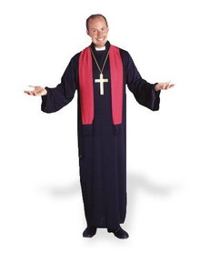
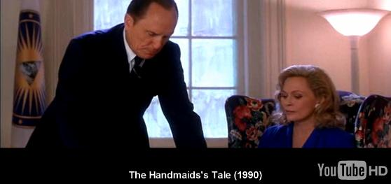

Slide 7
Costumes
Within the novel and within the society of Gilead
Commanders: black – fear, authority
Wives: powder blue (cf. the Madonna), status reinforced by the “richness of their costumes, with details of embroidery.”

Slide 8
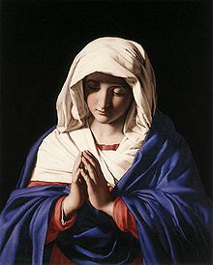
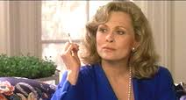

Slide 9
Costumes
Within the novel and within the society of Gilead
Commanders: black – fear, authority
Wives: powder blue (cf. the Madonna), status reinforced by the “richness of their costumes, with details of embroidery.”
Aunts: brown/khaki – Nazi stormtroopers were known as ‘Brownshirts’, khaki is an army color

Slide 10
Costumes
Girls: white – purity

Slide 11
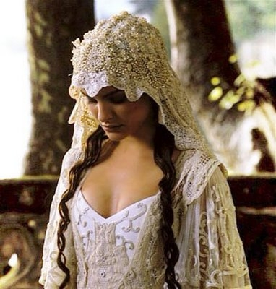
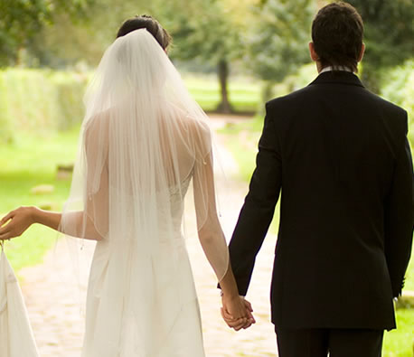

Slide 12
Costumes
Girls: white – purity
Econowives: wear stripes – red, blue, green, symbolizing they fulfill all three roles. Stripes cf. prisoners

Slide 13
Costumes
Handmaid: wear red, symbol of fertility, their primary function
Obvious reference to female reproductive system
“The color of blood which defines us” [p 11]
Menstrual blood = sign of failure
Blood also present at childbirth

Slide 14
Costumes
Blood also traditional marker of sexual sin
- scarlet letter worn by Hester Prynne (Nathaniel Hawthorne or in the movie Easy A)
Whole body covered, removing individuality/identity, ironic parallels with nuns habits
- a nun takes a new name with her vow

Slide 15
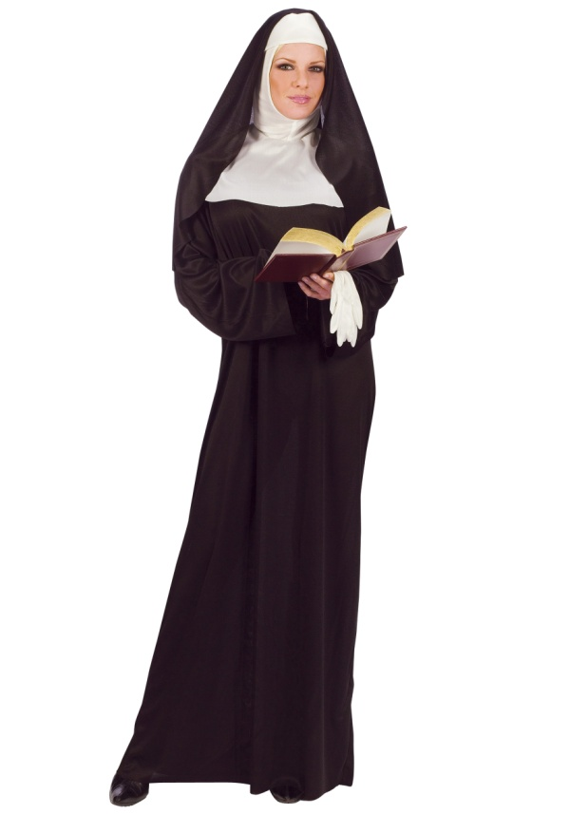
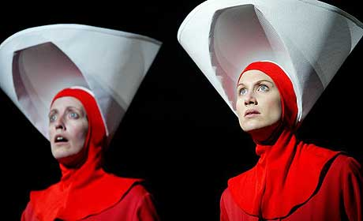
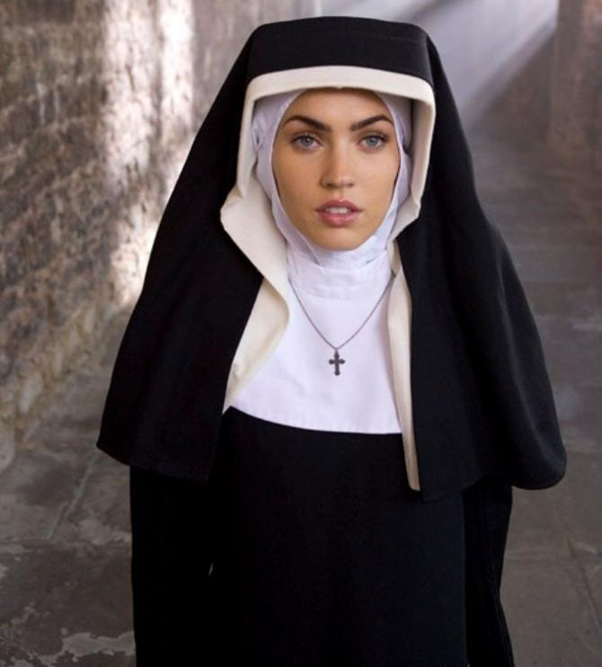

Slide 16
Costumes
“The white wings too are prescribed issue; they are to keep us from seeing, but also from being seen” [p 11]
“a red and white shape of cloth, like a kite” [p 362]

Slide 17
Costumes
Sexuality: the ‘scarlet woman’ = Jezebel
Blood = violence, red = danger, life and death
“I think about the blood…” [p 181]
“red spreads everywhere’ [p 359] (clothes or blood?)
‘A sister dipped in blood.” [p 11]

Slide 18
Red shoes
Repetitive image in much of Atwood’s writing
Origins in folk tale – little girl wore her wear red shoes and loved dancing in them. Later when they were removed she talked her foster mother into buying her some more. These new ones MADE her dance and she danced until she collapsed.
When she is in control, her creativity is good for her, but when society determines her role she loses control of her life.

Slide 19
Red shoes
“I get up out of the chair, advance my feet into the sunlight in their red shoes, flat-heeled to save the spine and not for dancing.” [p 10-11]
“My red shoes are off, my legs tucked up underneath me …” [p 237] – in the Commanders study
“I bend over to do up my red shoes; lighter weight these days, with discreet slits cut in them, though nothing so daring as sandals.” [p 258]
After the Salvaging: “Beneath the hems of the dresses the feet dangle, two pairs of red shoes … It could be a kind of dance, a ballet.” [p 356]
“I don’t want to be a dancer.” [p 368]

Slide 20
Mirrors
Mirrors reflect who we are. Without them, identity is lost. = symbolism of identity
They are all removed (cf. names and books)
- ostensible reason = break and make weapons
“As in a nunnery too, there are few mirrors.” [p 10]

Slide 21
Mirrors
One remains in the hall, but it distorts Offred’s reflection. She is vague, insubstantial in her reflection.
“… round, convex, a pier-glass, like the eye of a fish and myself in it like a distorted shadow, a parody of something …” [p #11]
“ … my face, distant and distorted, framed in the hall mirror, which bulges outward like an eye under pressure.” [p 65]
“a brief waif in the eye of the glass that hangs on the downstairs wall.” [p 101]
“In the curved hallway mirror I flit past, a red shape at the edge of my own field of vision, a wraith of red smoke.” [p #]

Slide 22
Mirrors
Offred and Ofglen use the window at Soul Scrolls as a way of seeing each other.
Offred describes Ofglen: “She’s like my own reflection, in a mirror from which I am moving away.” [p 59]
Jezebel’s: “Here they haven’t removed the mirror … you need to know, here, what you look like.” [p 314]
“I’m a wreck … a travesty in bad makeup and someone else’s clothes, used glitz.” [p 330] – Offred looks at herself
“I see the two of us, a blue shape, a red shape, in the brief glass eye of the mirror …” [p #] – Offred sees Serena Joy as not so different after all

Slide 23
Flowers, tulips, fruitfulness and vessels
There are parallels between tulips and Handmaids: the images link in color, function and death
Wine cups and chalices connect them to Christianity. Red wine, poured out in a chalice is symbolic of the blood of Jesus, his sacrifice (and is the basis of mass, communion, the Eucharist)
Chalice = open vessel and is compared to the womb = waiting to be filled to bear children
“We are two-legged wombs, that’s all: sacred vessels, ambulatory chalices.” [p 176]

Slide 24
Flowers, tulips, fruitfulness and vessels
Aunt Lydia’s reference to the 'Parable of the Sower': "Think of yourselves as seeds". [28/16]
"Blessed be the fruit," she says to me… "May the Lord open," I answer. [29/17]
Serena Joy’s veil is wreathed in embroidered flowers.
"No use for you, I think at her… you can't use them any more. They’re the genital organs of plants." [p. 105]

Slide 25
Flowers, tulips, fruitfulness and vessels
Offred on the Commander’s perception of her:
- "To him I'm not just a boat with no cargo, a chalice with no wine in it... To him I am not merely empty.“ [pg. 211]
Offred says of Nick: "… he too is human, more than just a seedpod" [pg.339]
Serena Joy's garden bursts with fecundity and fruitfulness.

Slide 26
Eyes
The 'Eyes of God' are Gilead's secret police. Both their name and their insignia, a winged eye, symbolise the eternal watchfulness of God and the totalitarian state. In Gilead's theocracy, the eye of God and of the state are assumed to be one and the same: “Under His Eye”
a wreath on the ceiling, the centre “like a place in the face where the eye has been taken out” [17/3]
“blind plaster eye in the ceiling”
tattoo: “four digits and an eye" [p. 84]
“. . . black painted van with the winged eye in white on the side” [31/20]

Slide 27
The Moon
Associated with a woman's monthly cycle.
"Every month there is a moon, gigantic, round, heavy, an omen. It transits, pauses, continues on and passes out of sight and I see despair coming towards me like famine." [84/70]
After the ceremony, Offred in her room: "The moon on the breast of the new-fallen snow. . . in the obscured sky a moon does float, newly, a wishing moon, a sliver of ancient rock, a goddess, a wink." [108/93]
"I tell time by the moon. Lunar, not solar." [209/193]
"dreamscape in the moon-filled sitting room" [190/177]

Slide 28
Sexual Violence
Sexual violence, particularly against women, pervades the novel.
the prevalence of rape and pornography in the pre-Gilead world justified to the founders their establishment of the new order.
The Commander and the Aunts claim that women are better protected in Gilead, that they are treated with respect and kept safe from violence. The official penalty for rape is terrible – death – though the victim at the Particicution is actually a dissident, not a rapist.
Yet while Gilead claims to suppress sexual violence, it actually institutionalises it:
Jezebel's provides the Commanders with a ready stable of prostitutes to service the male elite.
the central institution of the novel, the Ceremony, compels Handmaids to have sex with their Commanders.

Slide 29
Other motifs and symbols
hanging bodies – Offred's predecessor, the people on the wall, Ofglen
amputation and dismemberment
Serena Joy's "now amputated glory" [64/52]
"headless chicken" – explicitly linked to Offred (See 'Narrative Structure') [57/44]
knives, shears, razors blades, sharp edges
falling – in love, fallen women, falling hair, the Garden of Eden etc

Slide 30
Other motifs and symbols
the wreath [17/3; 47/35; 61/49; 108/93; 119/101; 138/121; 210/194; 223/207; 233/218] (It is interesting to note how often these references are at the start of a chapter.)
light and dark
time and waiting
the match = a symbol of freedom, of the ability to fight back

Slide 31
Other motifs and symbols
A palimpsest is a document on which old writing has been scratched out, often leaving traces, and new writing put in its place. Offred describes the Red Centre as a palimpsest, but the word actually symbolises all of Gilead. The old world has been erased and replaced, but only partially, by a new order. Remnants of the pre- Gilead days continue to infuse the new world; like the medieval monk, Gilead has tried to erase the immediate past but this proves impossible. The language throughout the novel is redolent with echoes.
The new Ofglen tells Offred: "You ought to make an effort… to clear your mind of such… echoes." [296/282]

