Slide 1
Dose-Response Relationships

Slide 2
Chemicals in the Body
Chemicals vary widely in their toxicity.
A chemical’s structure determines:
How it is metabolized by the body
How quickly the chemical is absorbed by the body
How it is excreted by the body
Individual differences influence how susceptible each person is to the same toxin.

Slide 3
Defining Dose-Response
Toxicologists study the connection between a exposure to a chemical and the effects caused by that chemical by looking at dose-response relationships.
Dose refers to the amount or concentration of the chemical
Response refers to the produced effect or resulting changes in body function
These studies are central to determining “safe” levels and dosages for drugs, pollutants, or other chemicals.

Slide 4
Factors Affecting Dose-Response
Dose Amount – A measure of the magnitude of the dose
Dose Frequency – How often exposure occurs, e.g., daily, once a week, etc.
Dose Duration – How long a total period of time the dose exposure occurs, e.g., a week, a month, a lifetime

Slide 5
Factors Affecting Dose-Response
Subject Variability (Natural) – Individual characteristics such as age, sex, weight, ethnic background, or genetics
Subject Variability (Health) – Presence of pre-existing conditions such as asthma, diabetes, or other diseases that may make a person more susceptible to an agent
Route of Exposure – The way in which a person is exposed

Slide 6
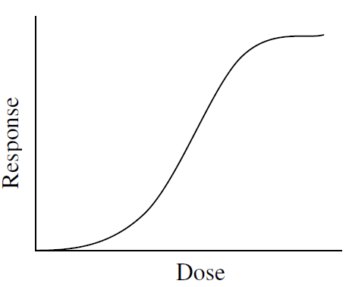
Dose-Response Curves
A dose-response relationship can be shown using a dose-response curve
Dose is plotted on the x-axis
Response is plotted on the y-axis
Dose-response curves typically take an S-shape. As the dose increases, the response increases.

Slide 7
Threshold Value / Dose
For most relationships, there is a dose, called a threshold, below which there are no adverse effects from the chemical.
Cells in the body can break down chemicals into nontoxic substances that will be eliminated in urine or feces.
Therefore, the body can often combat some toxins up to a certain point and still remain healthy.

Slide 8
Threshold Value / Dose
The threshold value is followed by a range of exposures over which response increases to a maximum. Beyond this point, increasing the dose shows no additional increase in response.
The faster a substance produces an effect in the body, the steeper the curve will be.

Slide 9
Threshold Value / Dose
A sharp increase in the slope of the curve suggests higher risk of toxic response as dose increases.
A relatively flat slope suggests that the effect of an increase in dose is minimal.

